Slide 1


THE FUTURE OF FUELS
The National United Voice for Fuel Marketers
DAN GILLIGAN
PRESIDENT
Petroleum Marketers
Association of America

Slide 2
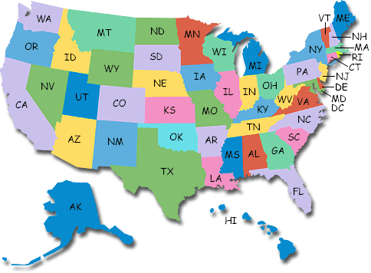
PMAA FEDERATION OF STATES

Slide 3

Transportation Fuels Are Liquid Fuels
Gasoline 125 Billion Gallons Per Year
Diesel 46 Billion Per Year

Slide 4
280 Million Passenger Vehicles
Estimated Fuel Source:
220 Million Gasoline
60 Million Diesel
120K CNG
150K LPG
4K LNG
10K Electric

Slide 5
FEDERAL GOVERNMENT
Deficit
Earmarks

Slide 6
ELECTRIC REALITIES
Automotive News, “Sales Do Not Match Hype”
220 Volt Chargers at C-stores?
Charger Tax Credit Expired 12-31-2012
$7,500 Tax Credit at Risk in Deficit Negotiators

Slide 7


Slide 8
E-15
Liability
Quality Control
Infrastructure

Slide 9
Cellulosic Ethanol
Isobutanol
Biobutanol

Slide 10
Gasoline Demand
CAFE
Tier 3
RFS2

Slide 11
Diesel
Biodiesel

Slide 12
Natural Gas
CNG
LNG
Gas to Diesel

Slide 13
PROPANE
150K Passenger Vehicles

Slide 14
PLEASE SUPPORT THE PMAA PAC
VISIT WWW.PMAA.ORG
PMAA: The National United Voice for Fuel Marketers

