Slide 1
Uintah Gateway Project
Presented to UPMRA Convention and Trade Show
Friday, September 13, 2013
CONFIDENTIAL - © 2012 Uintah Partners, LLC
© Uintah Gateway, LLC 2013 - All Rights Reserved.

Slide 2
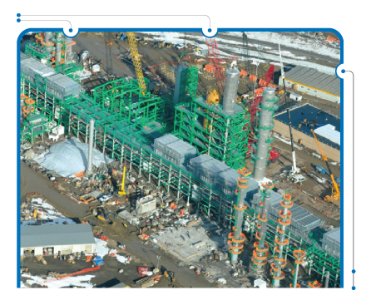
Uintah Gateway Project
I - Project Overview
CONFIDENTIAL - © 2012 Uintah Partners, LLC
© Uintah Gateway, LLC 2013 - All Rights Reserved.

Slide 3
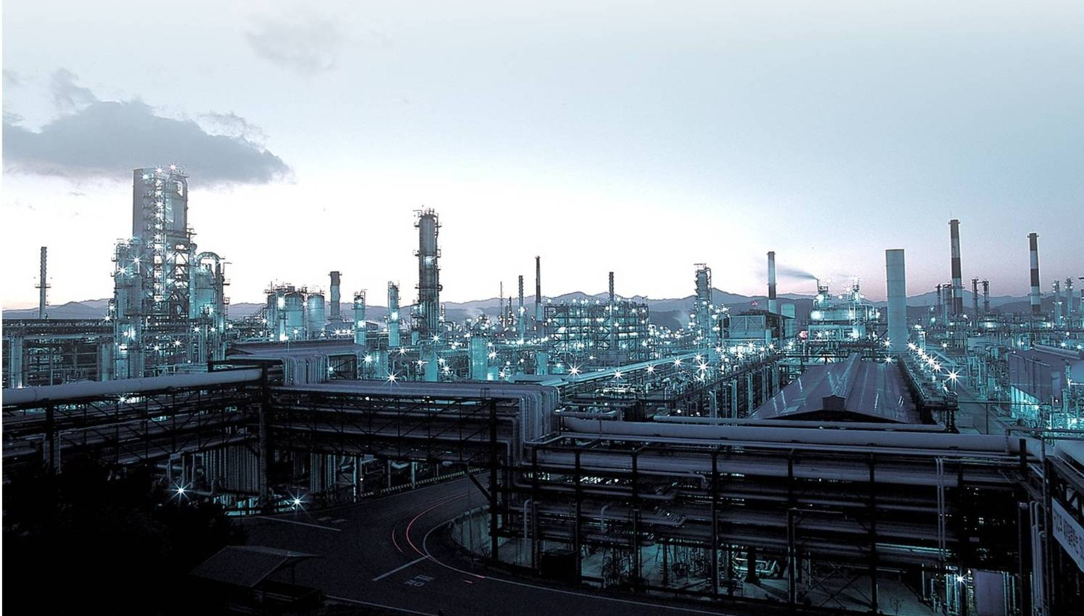
44,000 BPD Upgrading - Refinery (Phase 1)
CONFIDENTIAL - © 2012 Uintah Partners, LLC
© Uintah Gateway, LLC 2013 - All Rights Reserved.

Slide 4
Experienced Management Team
CONFIDENTIAL - © 2012 Uintah Partners, LLC
© Uintah Gateway, LLC 2013 - All Rights Reserved.

Slide 5
Experienced Management Team
Founder of Red Leaf Resources, Inc
Inventor & Patent Author of Red Leaf’s Technology
(EcoShale Process)
Former Chairman and largest shareholder
of Red Leaf Resources, Inc.
Founded Uintah Resources / Uintah Partners
Chemical Engineer – Started at Exxon’s Baytown
Refinery, TX
Former Flying J – Refining Manager
20 Years Experience in Black and Yellow Wax
Refining Experience in Utah
Built last FCC in Utah with IAG as Owner’s
Representative
One of few oil shale refining experience in world –
U.S. DOE Contract
CONFIDENTIAL - © 2012 Uintah Partners, LLC
© Uintah Gateway, LLC 2013 - All Rights Reserved.

Slide 6
Uintah Basin Wax Crude Oil – Problems and Solutions
PROBLEMS
SOLUTIONS
Pipeline transportation issue (pour point)
Limited (Single) Purchasing Market
Constrained Salt Lake FCC cracking ability
Erratic, steep discounts due to over supply
Future over supply is inevitable given local
producers future production forecast
More FCC cracking in the region
Process crude to lower its pour point
Utilize existing pipelines to open up new markets
Establish additional FCC processing
capacity to ensure long-term crude production
CONFIDENTIAL - © 2012 Uintah Partners, LLC
© Uintah Gateway, LLC 2013 - All Rights Reserved.

Slide 7
Historic Differential Below WTI
Crude Supply
CONFIDENTIAL - © 2012 Uintah Partners, LLC
© Uintah Gateway, LLC 2013 - All Rights Reserved.

Slide 8
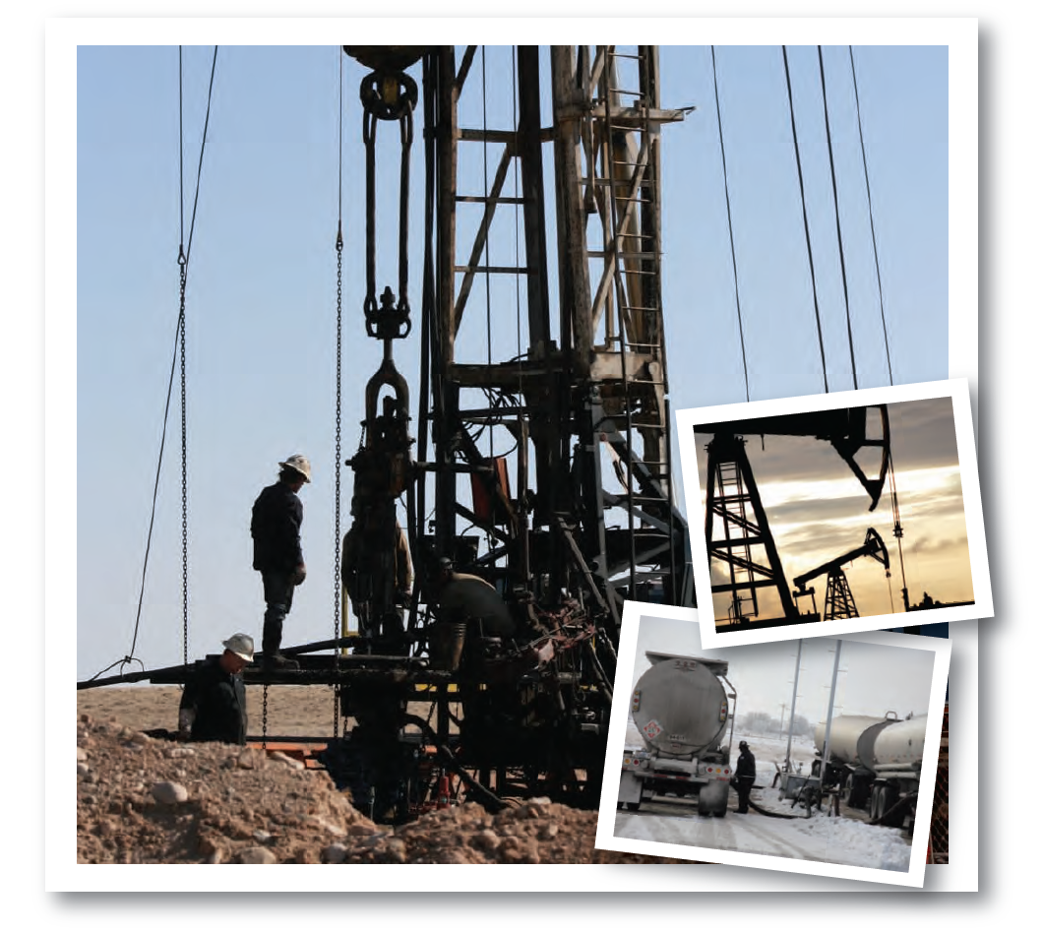
Uintah Basin’s Crude Oil Production is Rapidly Expanding
Production Increase
Producers are growing 10-15% on
average each year in the Uintah Basin
drilling due to new horizontal well and
fracking technology
Oil Wells
~4,500 wells currently producing in the
Uinta Basin. By 2020 it is estimated
there will be over ~8,500 new wells
New Companies Entering Basin
- Cresent Point acquired Ute Energy
- LINN Energy acquiring Berry Petroleum
CONFIDENTIAL - © 2012 Uintah Partners, LLC
© Uintah Gateway, LLC 2013 - All Rights Reserved.

Slide 9
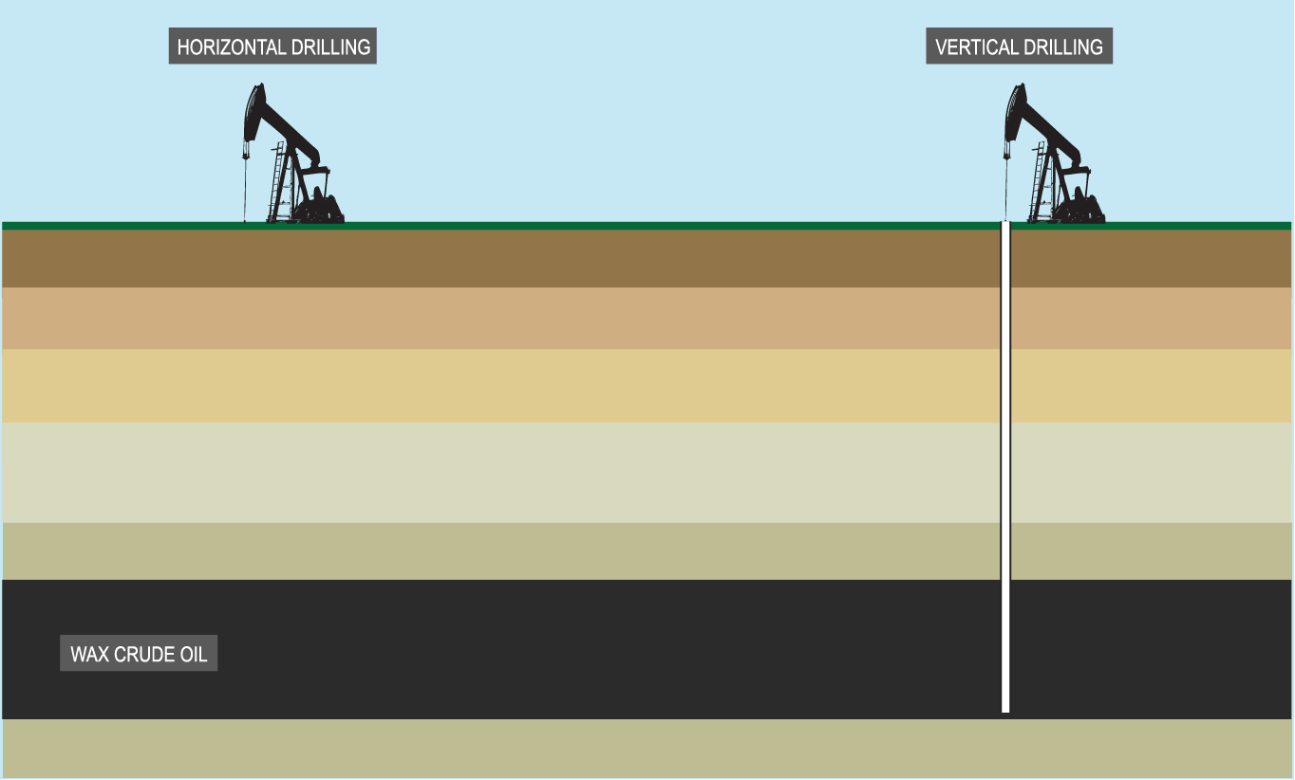
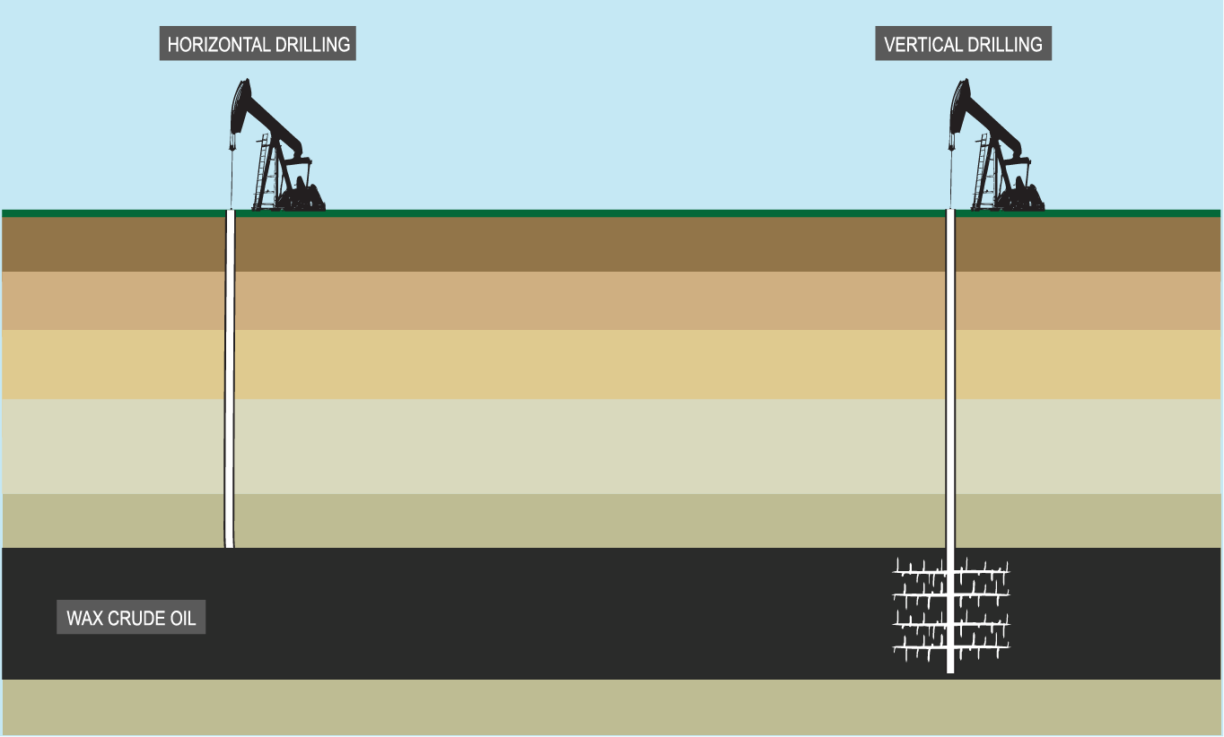
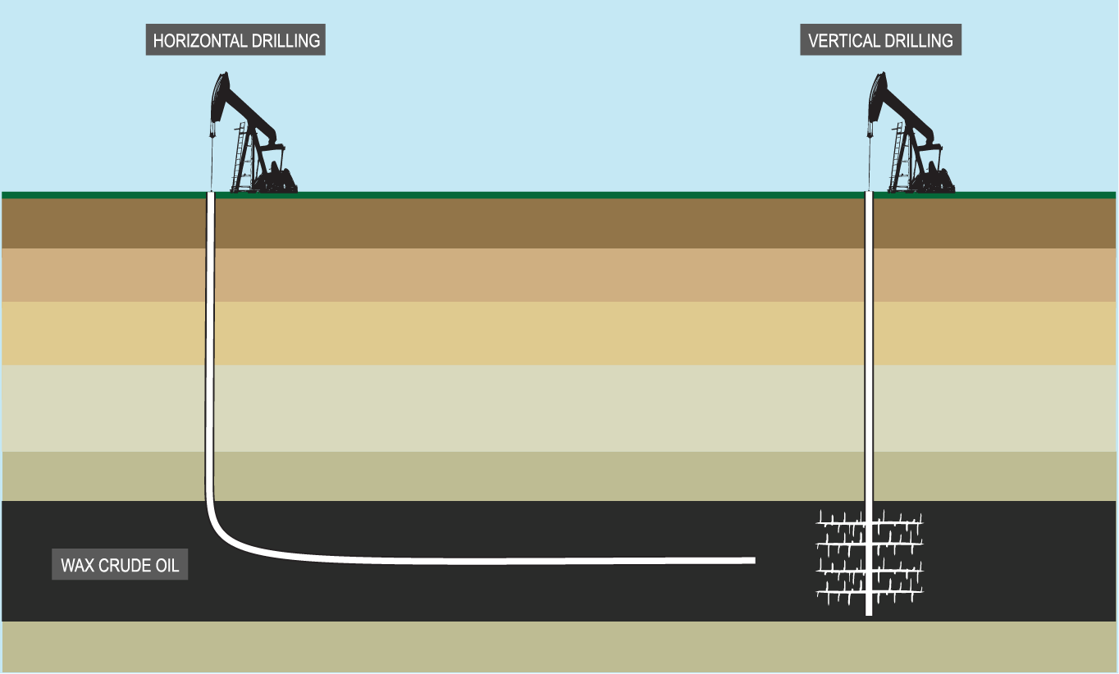
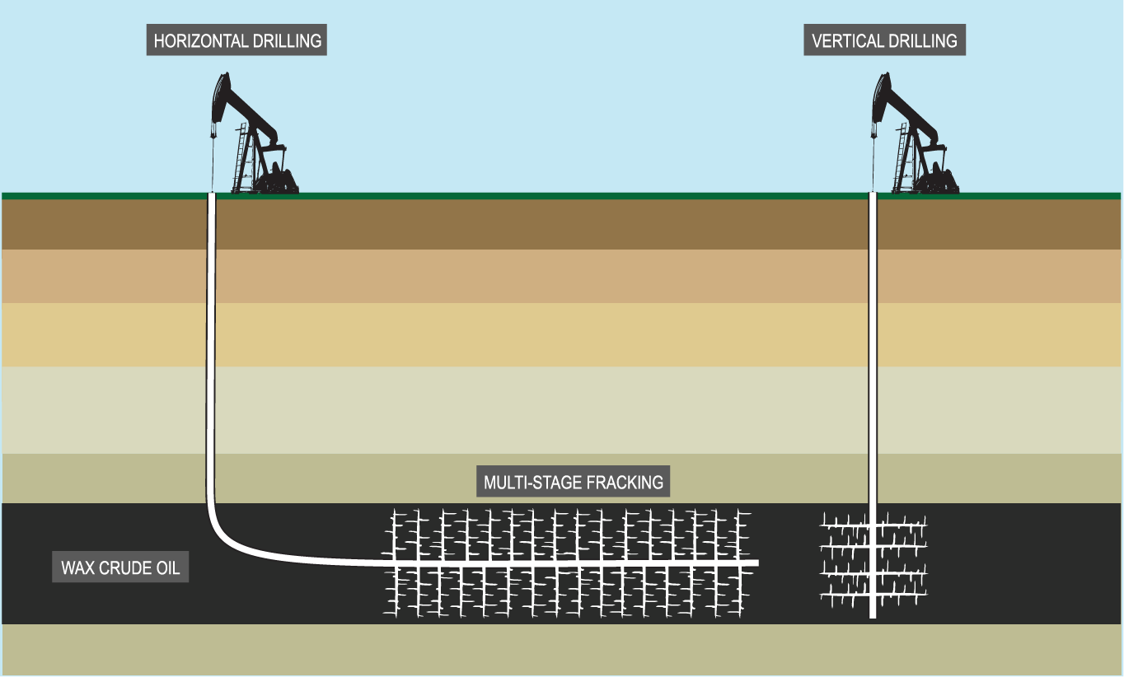
Horizontal Drilling and Fracking
Horizontal Drilling Combined with New Fracking Technology Increases Wax Crude Production
© Uintah Gateway, LLC 2013 - All Rights Reserved.

Slide 10
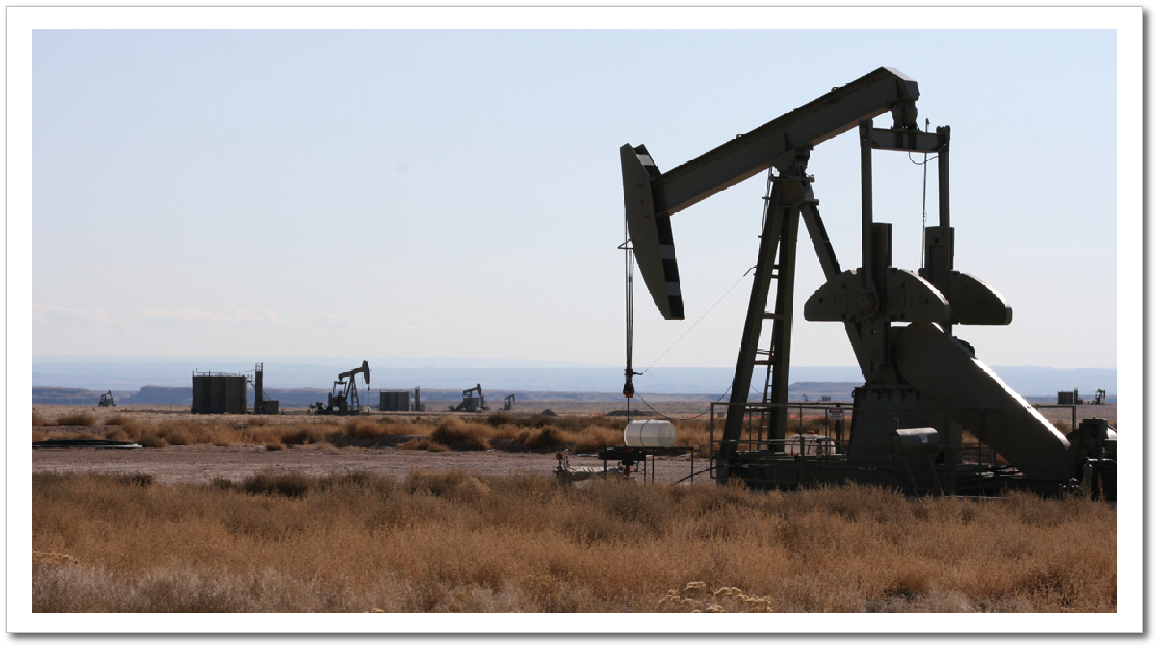
Wax Crude Oil Wells – Uintah Gateway Property
108,000 bpd
Capacity after Phase 2
Uintah Gateway Project
88,000 bpd
Capacity after Phase 1
Uintah Gateway Project
CONFIDENTIAL - © 2012 Uintah Partners, LLC
© Uintah Gateway, LLC 2013 - All Rights Reserved.

Slide 11
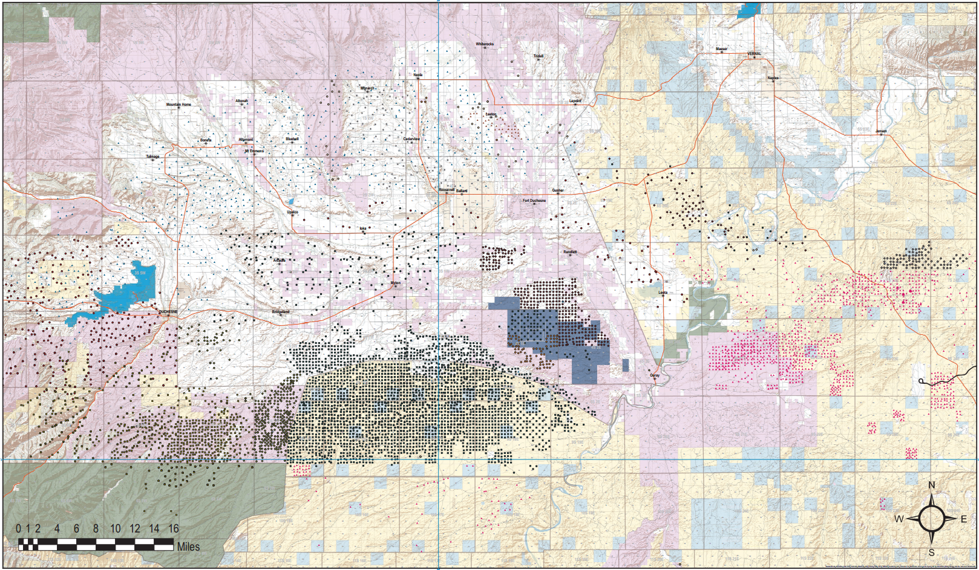
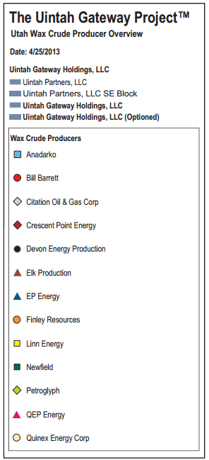
Uintah Gateway Black and Yellow Wax Oil Well Map
CONFIDENTIAL - © 2012 Uintah Partners, LLC
© Uintah Gateway, LLC 2013 - All Rights Reserved.

Slide 12
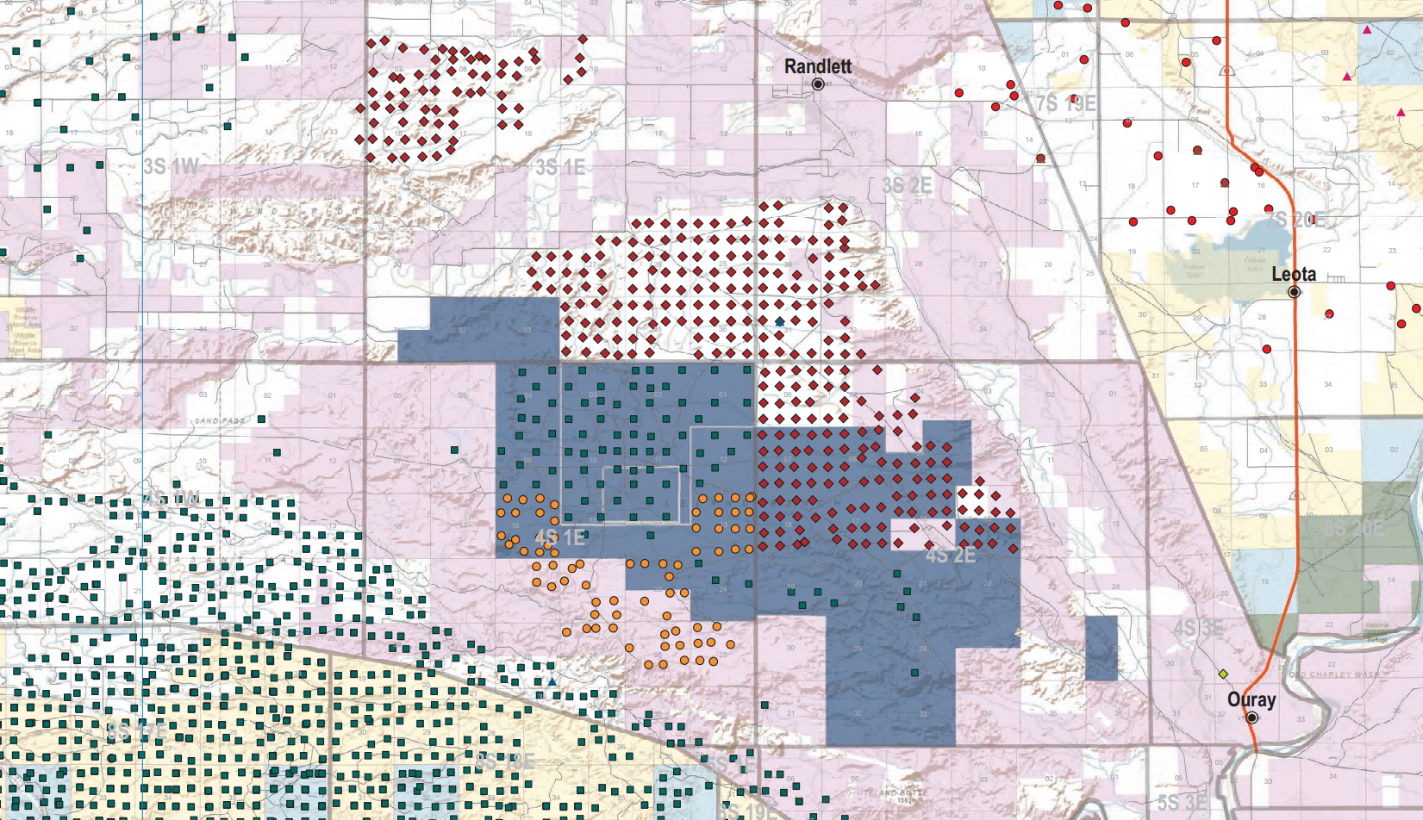
Uintah Gateway Black and Yellow Wax Oil Well Map
Uintah Gateway Project (20,000 Acres)
UTE Indian Tribe
CONFIDENTIAL - © 2012 Uintah Partners, LLC
© Uintah Gateway, LLC 2013 - All Rights Reserved.

Slide 13
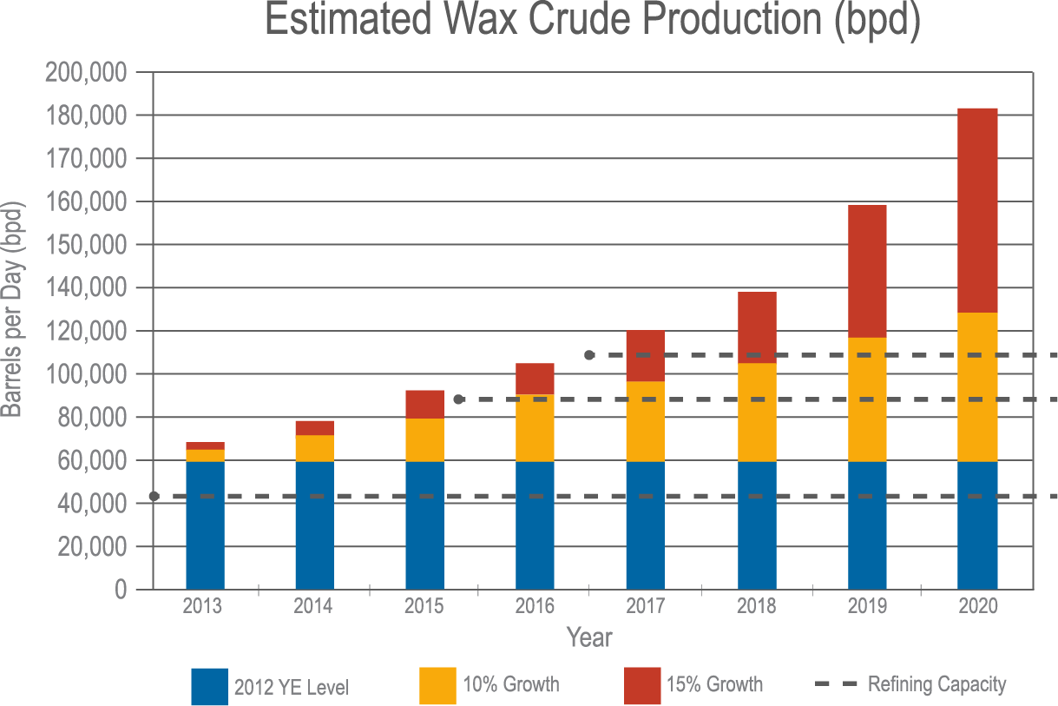
Black and Yellow Wax – State of Utah Total Production through 2020
108,000 bpd
Capacity after Phase 2
Uintah Gateway Project
88,000 bpd
Capacity after Phase 1
Uintah Gateway Project
~44,000 bpd
Capacity - Maximum
volume reached in Salt
Lake City, UT refineries
2013 YE Growth
CONFIDENTIAL - © 2012 Uintah Partners, LLC
© Uintah Gateway, LLC 2013 - All Rights Reserved.

Slide 14
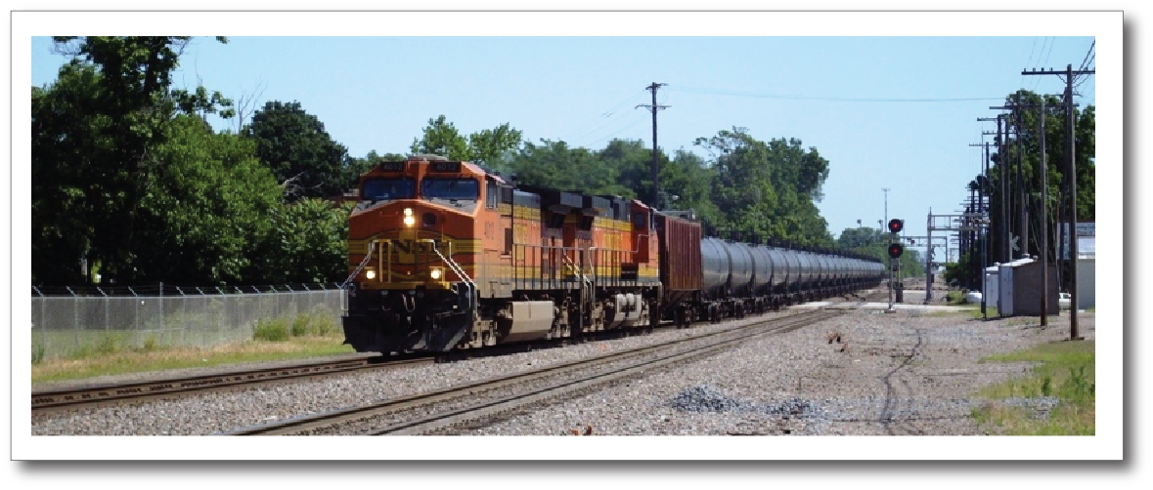
Rail Issues
Truck to Rail
Shortage of steam coil cars
Manifest car loading facilities
Need steam capable receiving terminal
Difficult for refineries to manage
Brent to WTI spread
CONFIDENTIAL - © 2012 Uintah Partners, LLC
© Uintah Gateway, LLC 2013 - All Rights Reserved.

Slide 15
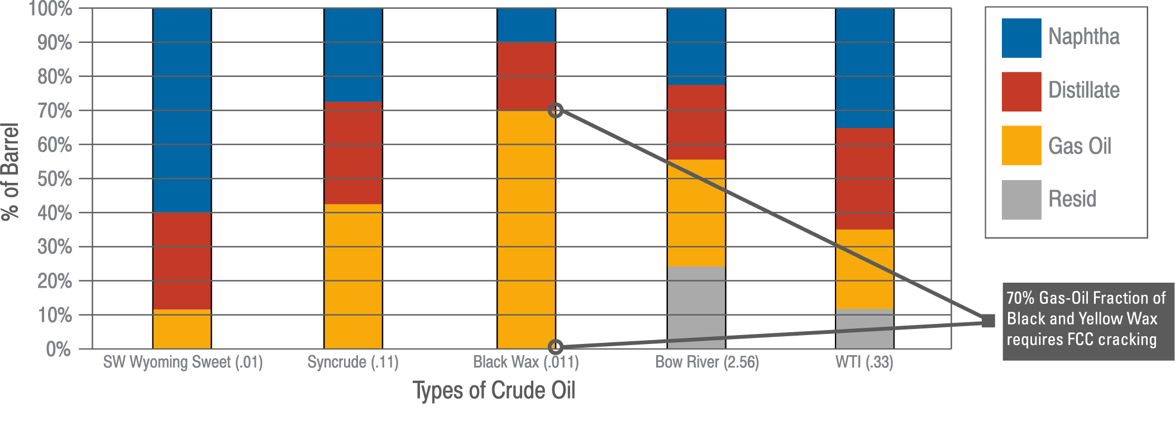
Black and Yellow Wax Gas-Oil Fraction Requires FCC Cracking
CONFIDENTIAL - © 2012 Uintah Partners, LLC
© Uintah Gateway, LLC 2013 - All Rights Reserved.

Slide 16
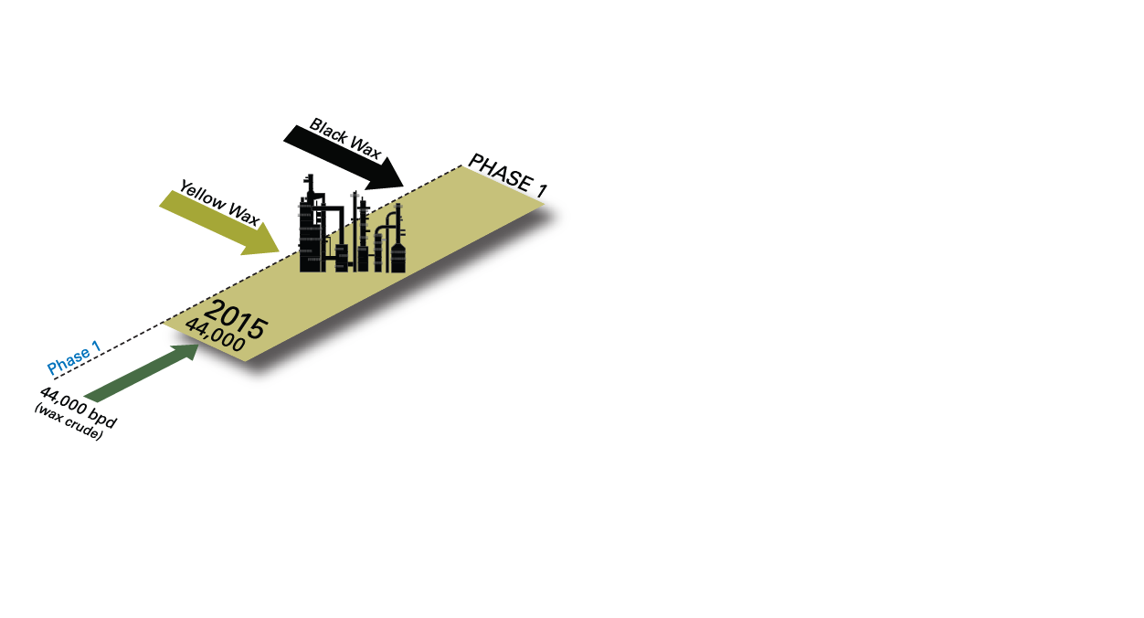
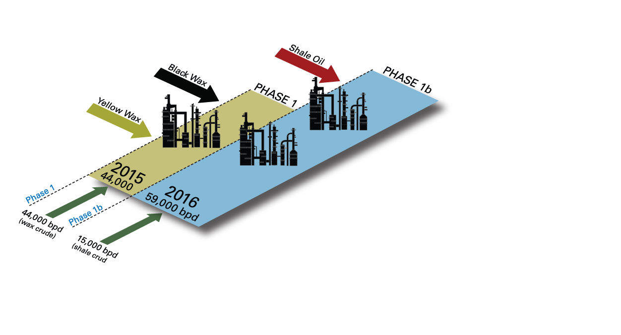
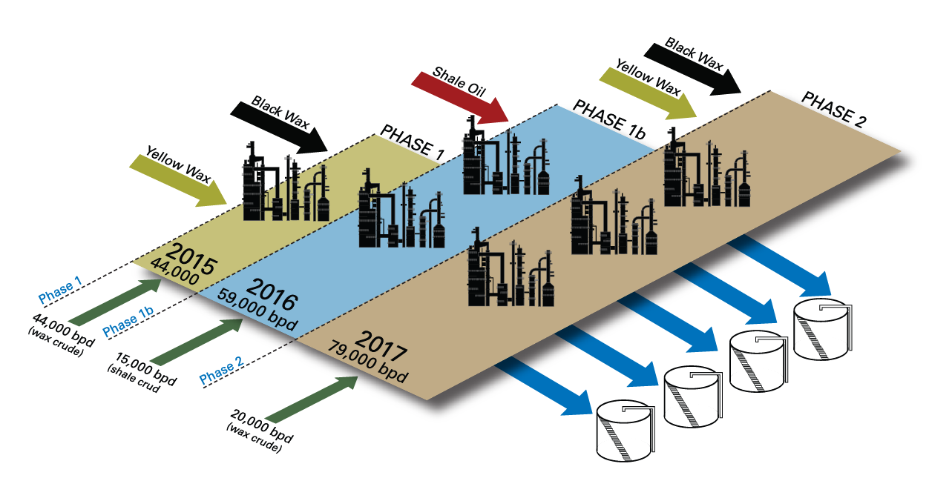
Uintah Gateway Project Phases
Phase 1
- 44,000 B/D Wax Crude Upgrading
- Immediate Cash Flow
- Develops Industrial Infrastructure
Phase 1b
- 15,000 B/D Shale Oil
(10,000 bpd – Total S.A)
Phase 2
- 20,000 B/D of additional Wax
crude Upgrading
64,000 – Black and Yellow Wax (Conventional Oil Drilling Production)
15,000 – Shale Oil Upgrading (Toll Processing)
79,000 - TOTAL
CONFIDENTIAL - © 2012 Uintah Partners, LLC
© Uintah Gateway, LLC 2013 - All Rights Reserved.

Slide 17
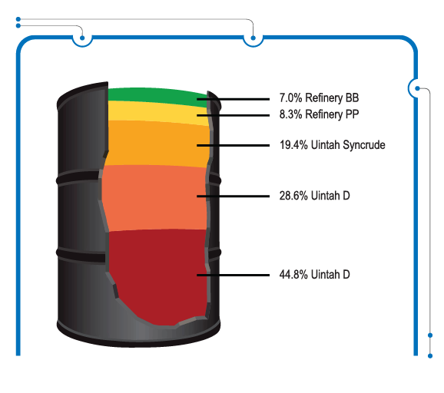
Uintah Gateway Project
II – Uintah Gateway Products
Refinery BB
Refinery PP
Uintah Syncrude
Uintah D
Uintah Plus
CONFIDENTIAL - © 2012 Uintah Partners, LLC
© Uintah Gateway, LLC 2013 - All Rights Reserved.

Slide 18
Uintah Gateway Products
Refinery BB
Olefinic LPGs (Butane/Butylene)
Refinery PP
Olefinic LPGs (Propane/Propylene)
Uintah Syncrude
Uintah D
Ultra Low Sulfur Diesel Blendstock
Uintah Plus
Gasoline Blendstock
CONFIDENTIAL - © 2012 Uintah Partners, LLC
© Uintah Gateway, LLC 2013 - All Rights Reserved.

Slide 19
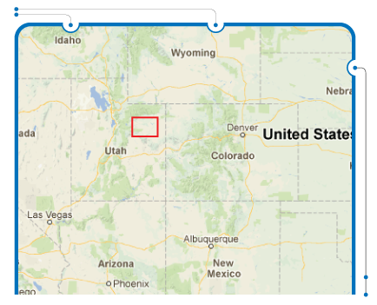
Uintah Gateway Project
III- Project Location
CONFIDENTIAL - © 2012 Uintah Partners, LLC
© Uintah Gateway, LLC 2013 - All Rights Reserved.

Slide 20
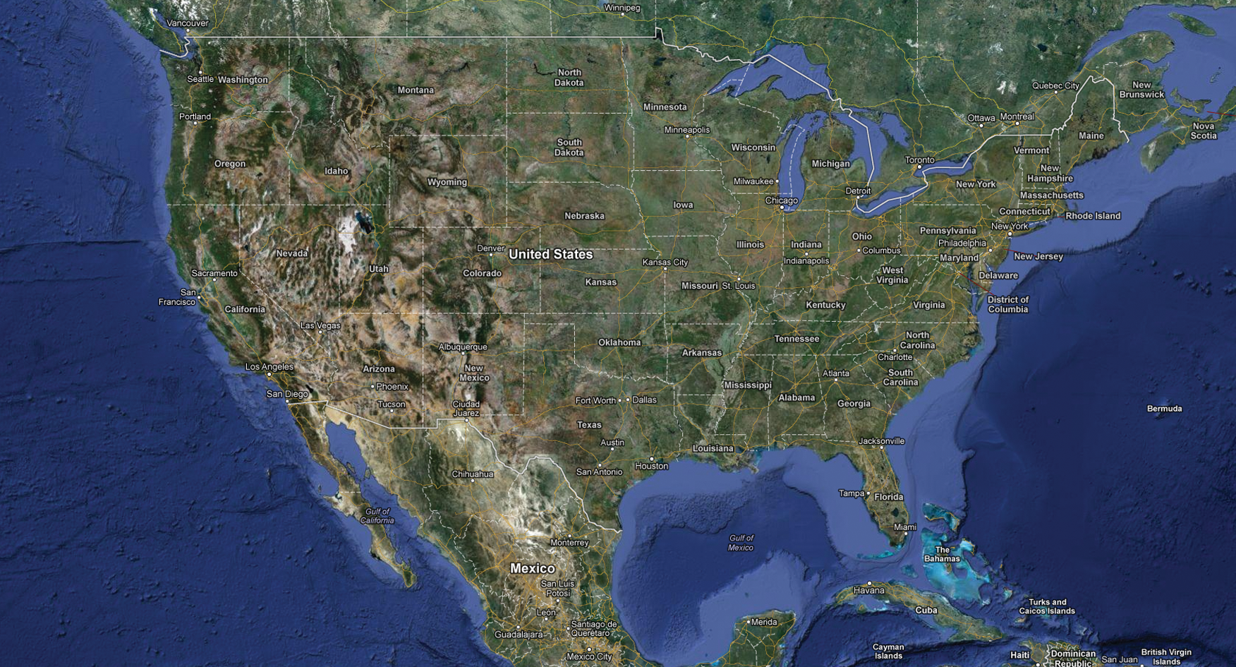
Project Location
CONFIDENTIAL - © 2012 Uintah Partners, LLC
© Uintah Gateway, LLC 2013 - All Rights Reserved.

Slide 21
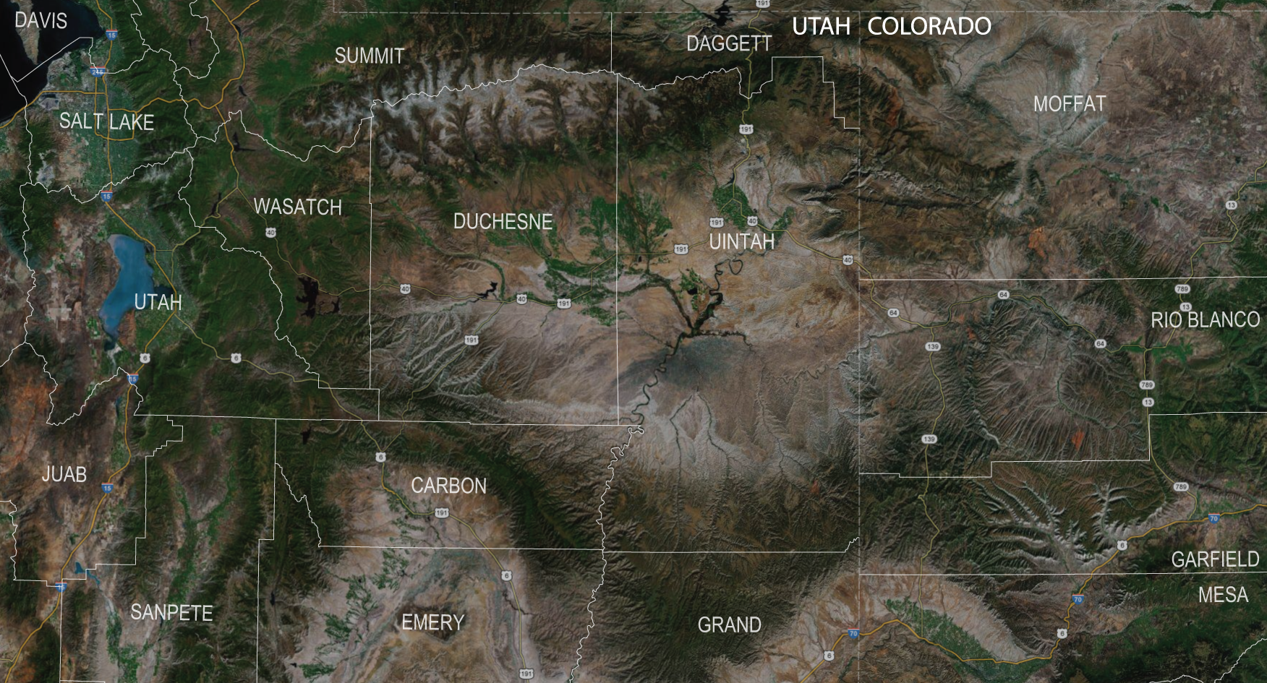
Project Location – Uinta Basin
CONFIDENTIAL - © 2012 Uintah Partners, LLC
© Uintah Gateway, LLC 2013 - All Rights Reserved.

Slide 22
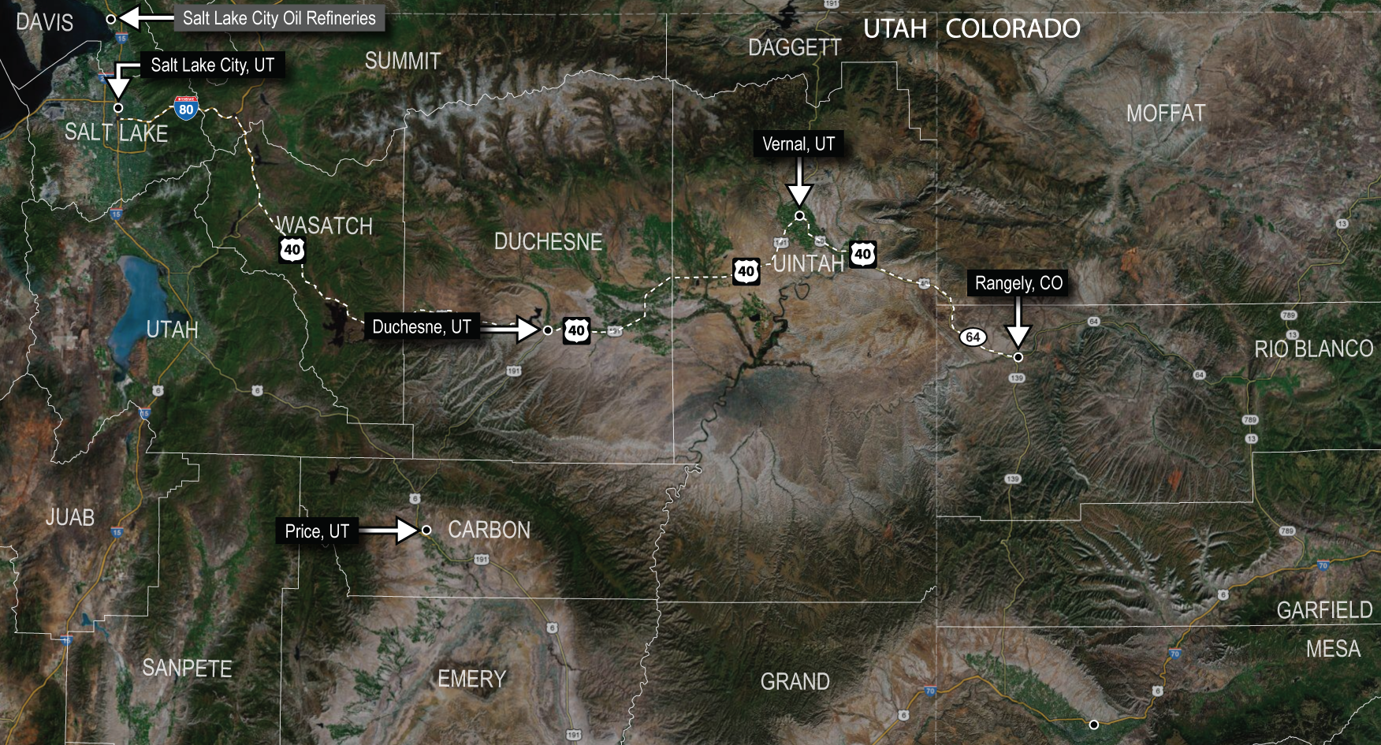
Community and Employment Base
CONFIDENTIAL - © 2012 Uintah Partners, LLC
© Uintah Gateway, LLC 2013 - All Rights Reserved.

Slide 23
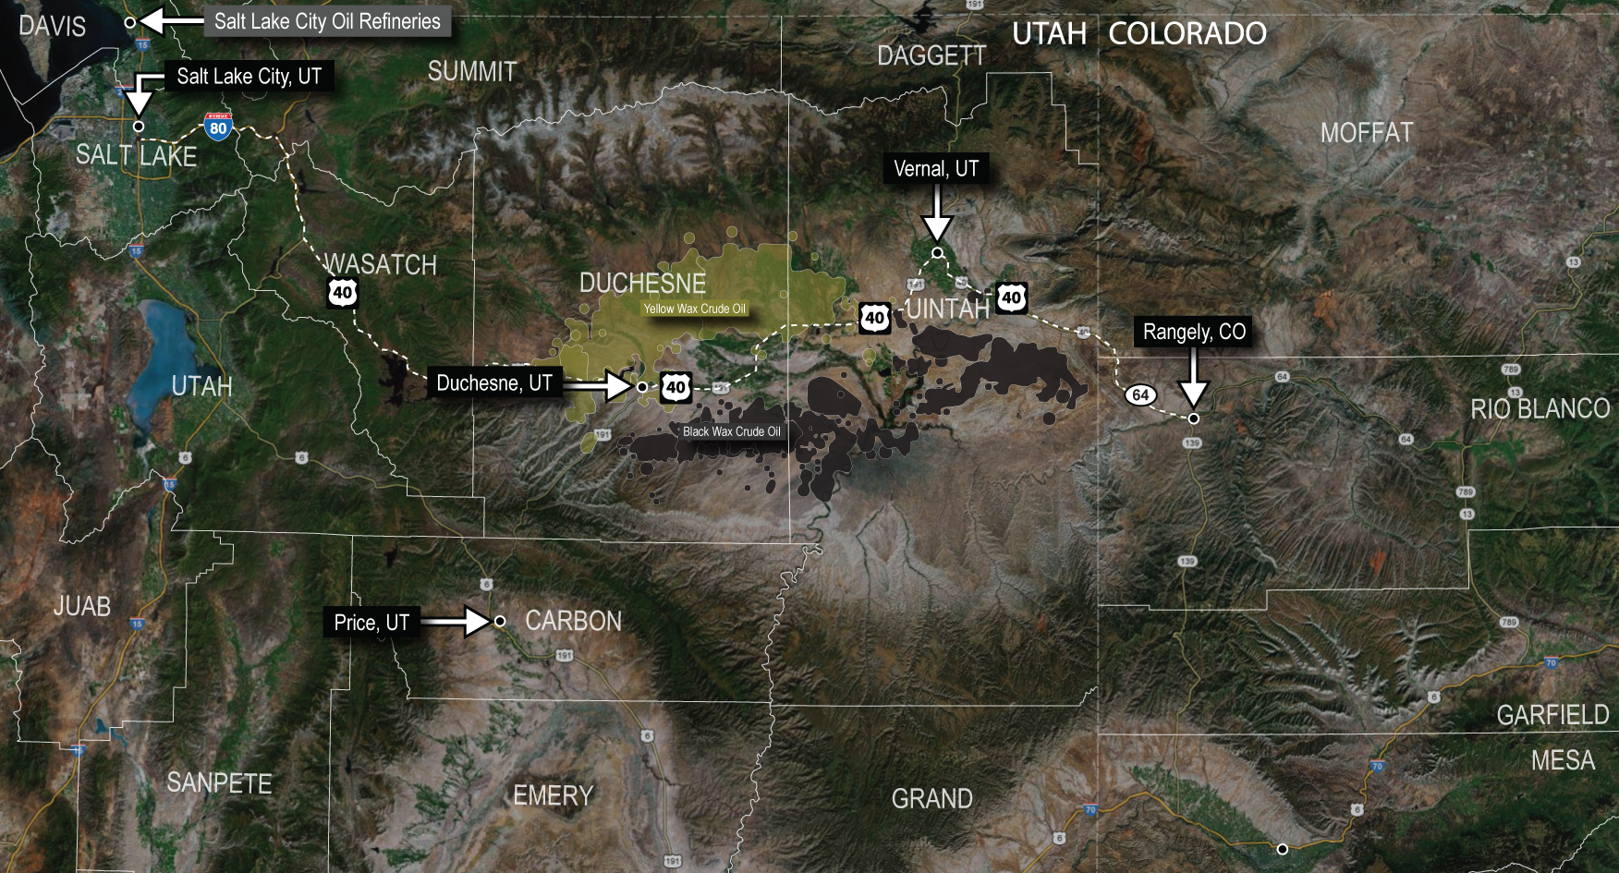
Black and Yellow Wax Resource
© Uintah Gateway, LLC 2013 - All Rights Reserved.

Slide 24
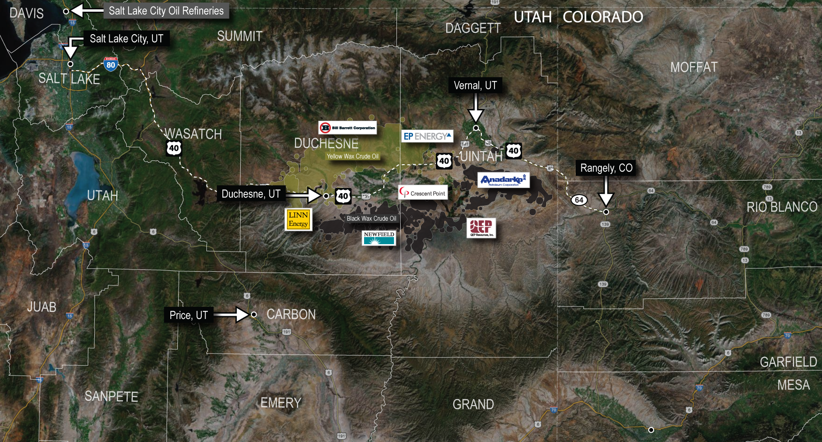
Black and Yellow Wax Producers
CONFIDENTIAL - © 2012 Uintah Partners, LLC
© Uintah Gateway, LLC 2013 - All Rights Reserved.

Slide 25
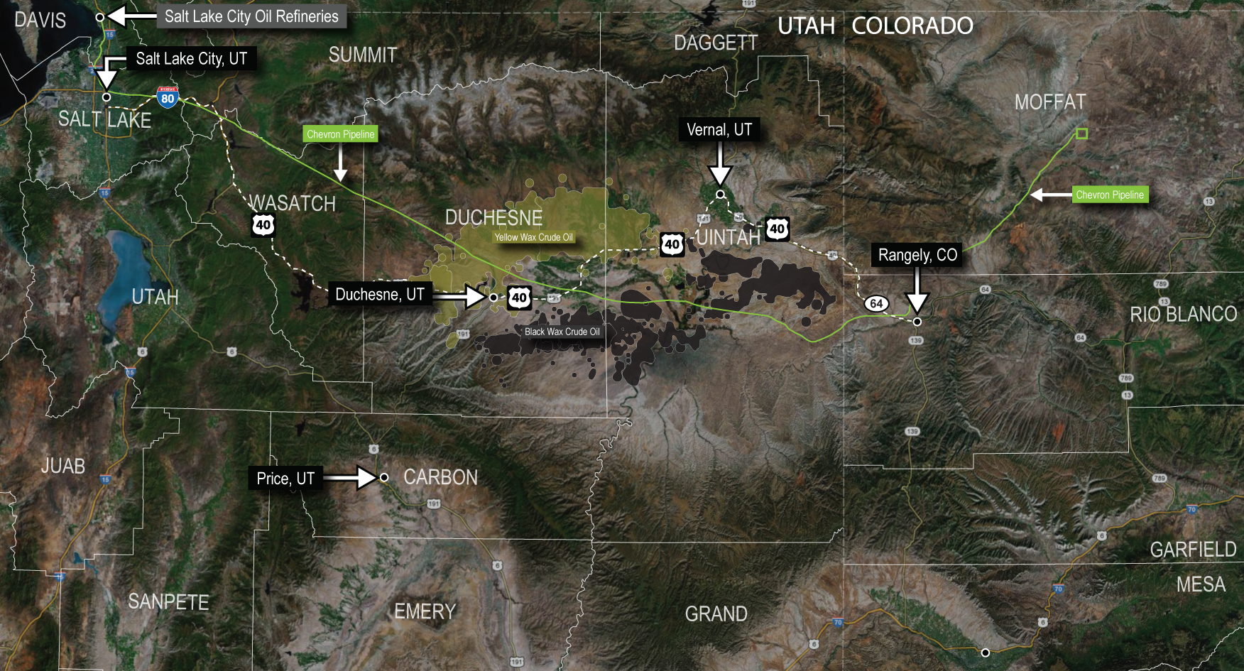
Crude Oil Pipelines
CONFIDENTIAL - © 2012 Uintah Partners, LLC
© Uintah Gateway, LLC 2013 - All Rights Reserved.

Slide 26
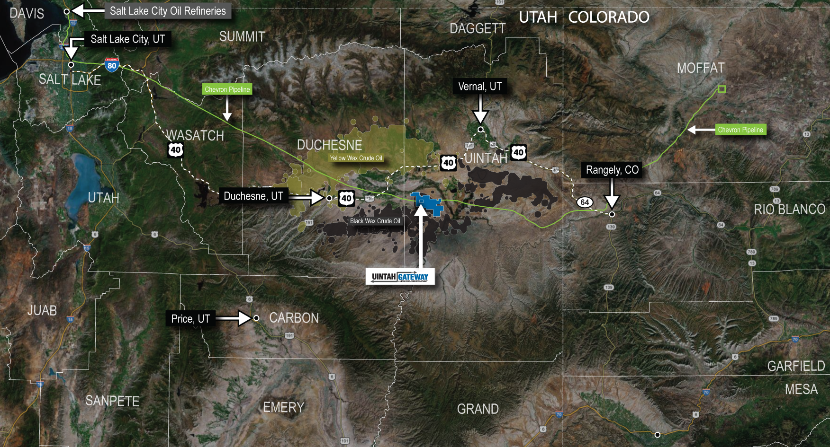
Uintah Gateway Project Property
CONFIDENTIAL - © 2012 Uintah Partners, LLC
© Uintah Gateway, LLC 2013 - All Rights Reserved.

Slide 27
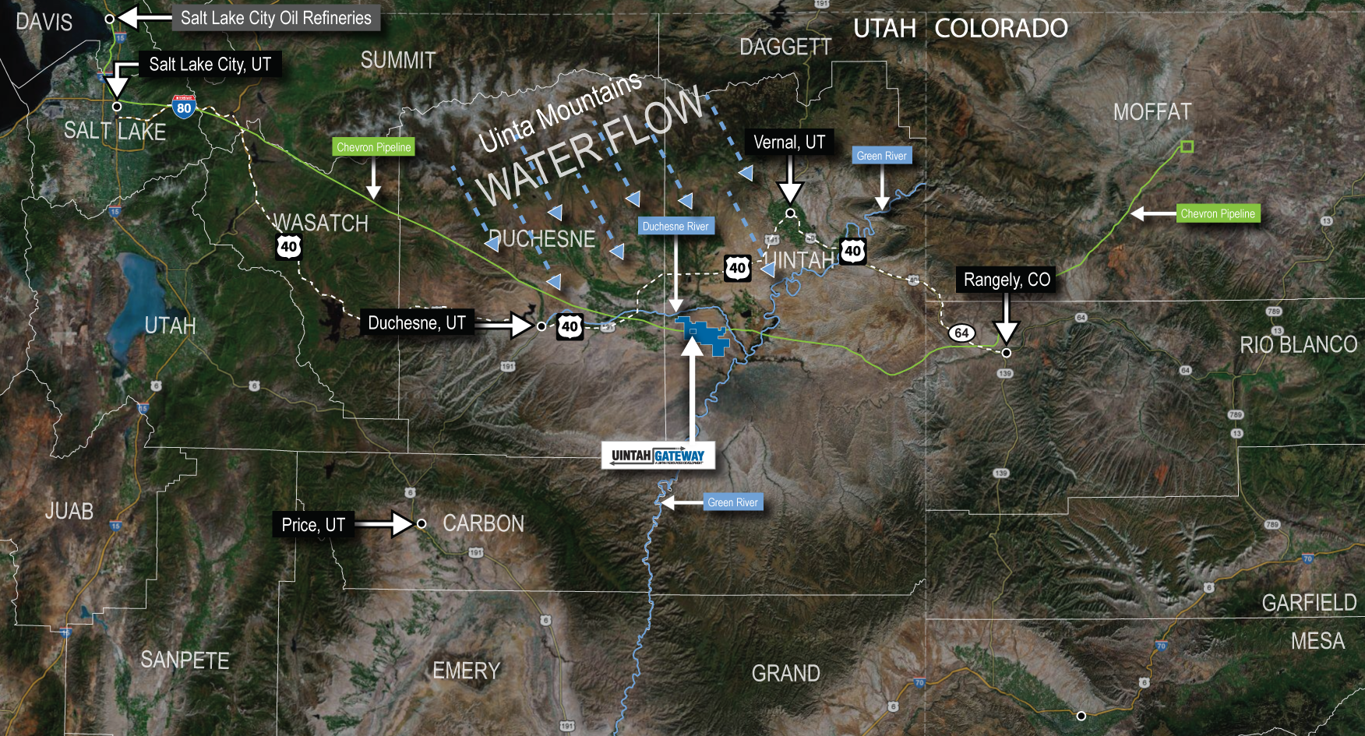
Water Supply
CONFIDENTIAL - © 2012 Uintah Partners, LLC
© Uintah Gateway, LLC 2013 - All Rights Reserved.

Slide 28
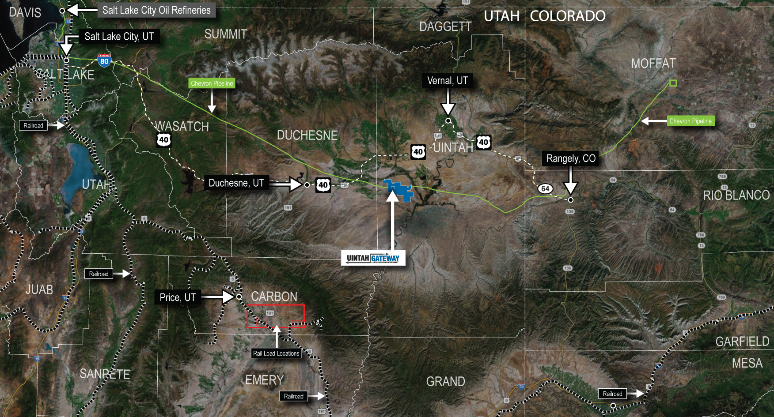
Utah Railroad – Loading Facility
CONFIDENTIAL - © 2012 Uintah Partners, LLC
© Uintah Gateway, LLC 2013 - All Rights Reserved.

Slide 29
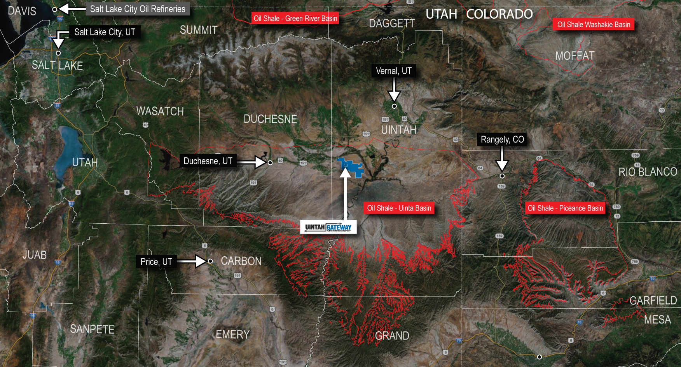
Oil Shale Resource Areas
CONFIDENTIAL - © 2012 Uintah Partners, LLC
© Uintah Gateway, LLC 2013 - All Rights Reserved.

Slide 30
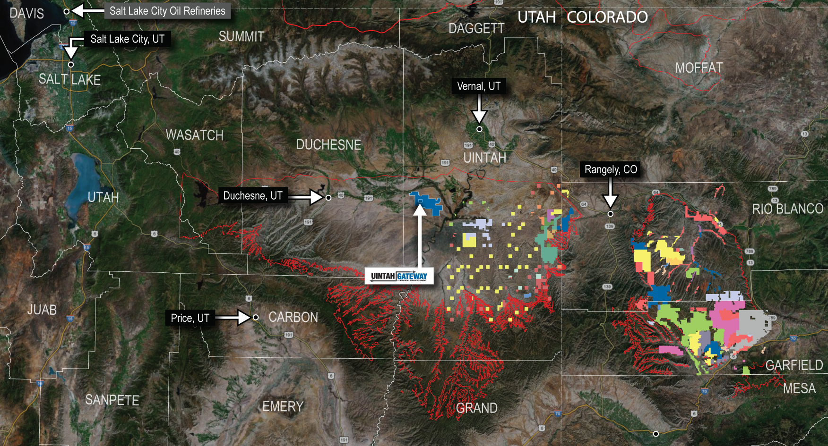
Oil Shale Resource Private Properties
CONFIDENTIAL - © 2012 Uintah Partners, LLC
© Uintah Gateway, LLC 2013 - All Rights Reserved.

Slide 31
Key Partnership: TOTAL S.A. At a Glance
Taking reservation in Phase 1b to support project
financing for future oil shale
Funding Red Leaf Resources (Mr. Dana’s
former company and technology invention for oil shale
mining project development)
CONFIDENTIAL - © 2012 Uintah Partners, LLC
© Uintah Gateway, LLC 2013 - All Rights Reserved.

Slide 32
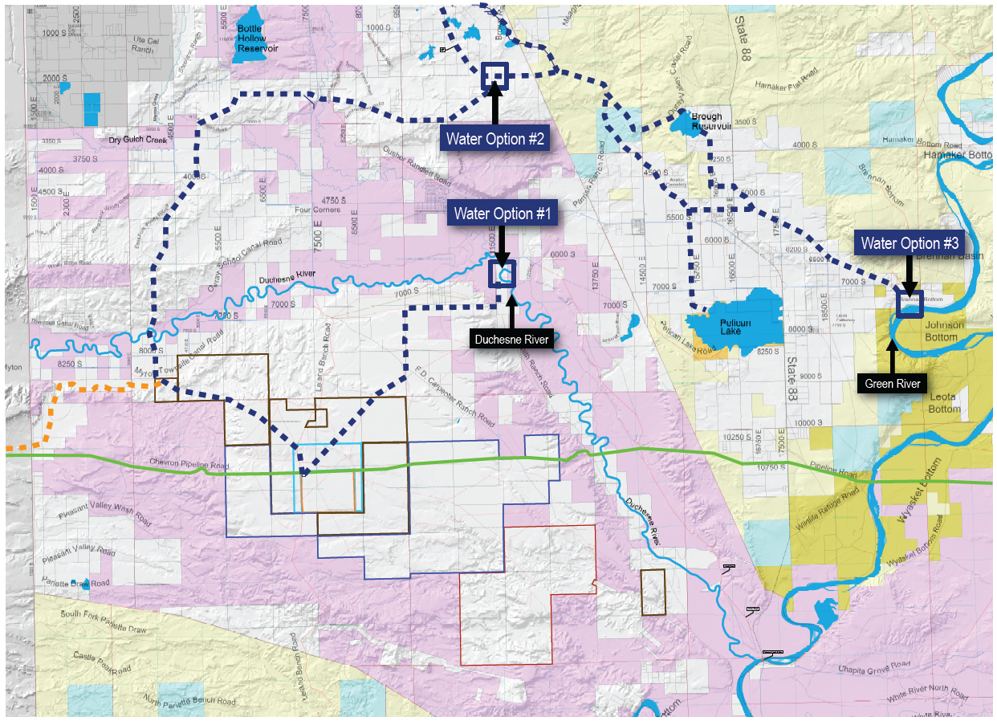
Uintah Gateway Project Right of Ways - Water
Water Lease Agreement with Uintah Water Conservatory District for 2,700 Acre Feet per year
CONFIDENTIAL - © 2012 Uintah Partners, LLC
© Uintah Gateway, LLC 2013 - All Rights Reserved.

Slide 33
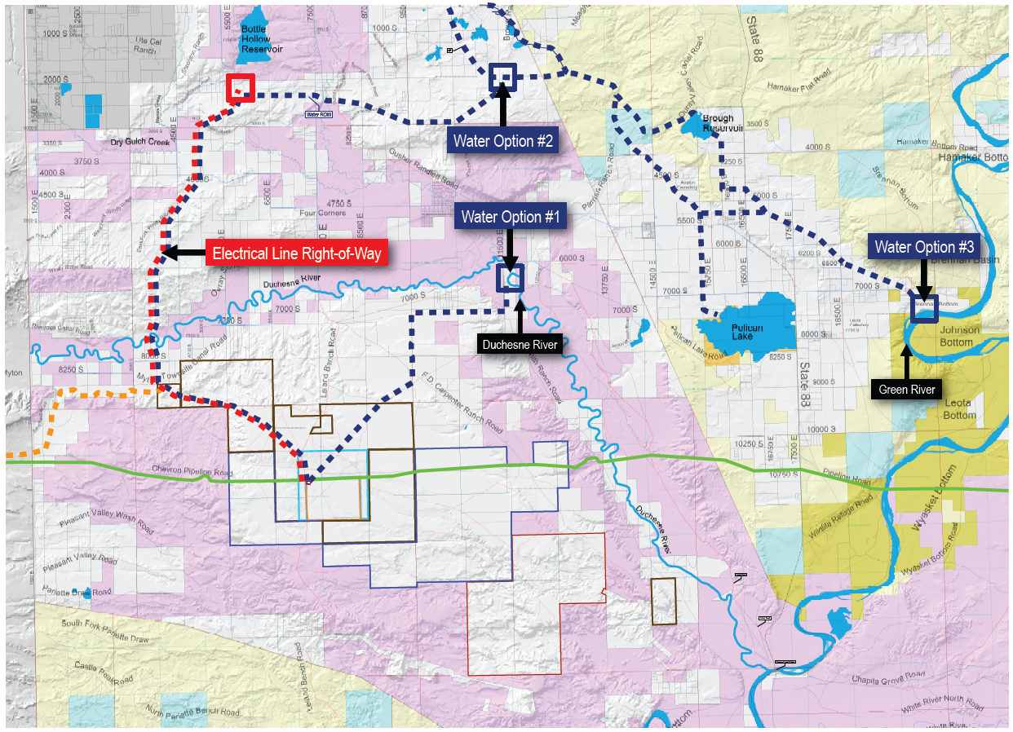
Uintah Gateway Project Right of Ways - Electrical
CONFIDENTIAL - © 2012 Uintah Partners, LLC
© Uintah Gateway, LLC 2013 - All Rights Reserved.

Slide 34
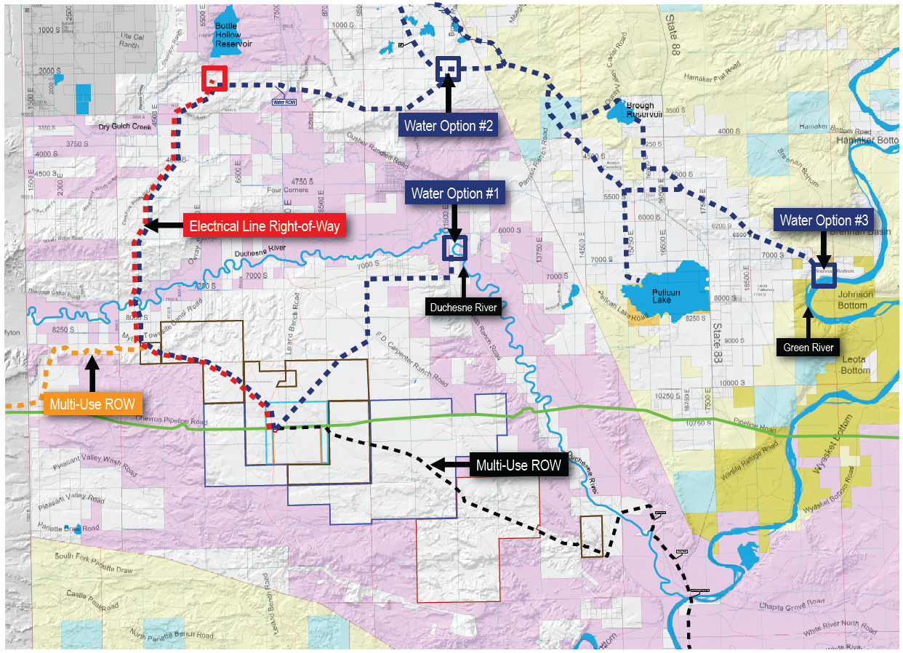
Uintah Gateway Project Right of Ways - Other
CONFIDENTIAL - © 2012 Uintah Partners, LLC
© Uintah Gateway, LLC 2013 - All Rights Reserved.

Slide 35
Uintah Gateway Project
IV – Air Permit Approval (Minor Source)
CONFIDENTIAL - © 2012 Uintah Partners, LLC
© Uintah Gateway, LLC 2013 - All Rights Reserved.

Slide 36
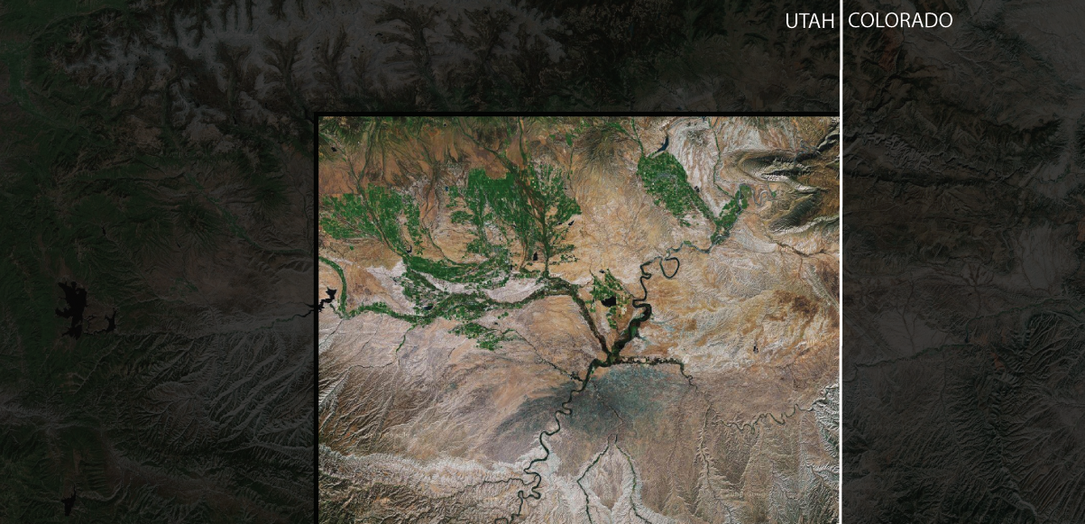
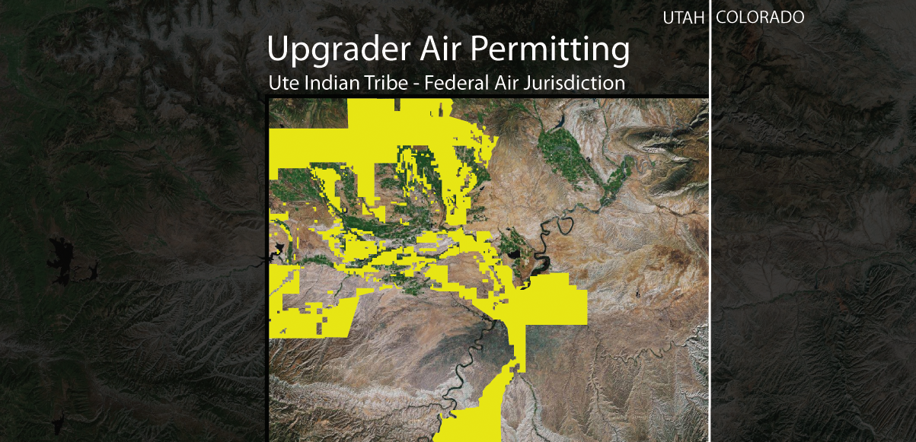
Air Jurisdiction
State of Utah air jurisdiction created by 100 year history of treaties with the Ute Indian Tribe, Executive Orders, and Court Cases.
Permitted by Utah and not Denver Region 8 EPA
© Uintah Gateway, LLC 2013 - All Rights Reserved.

Slide 37
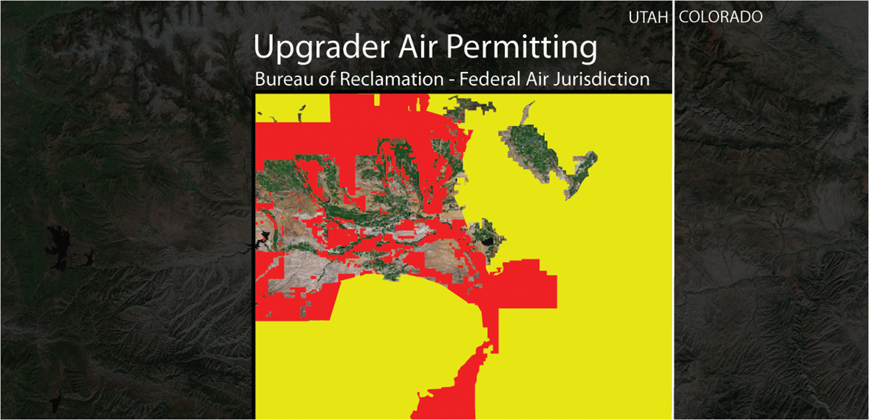
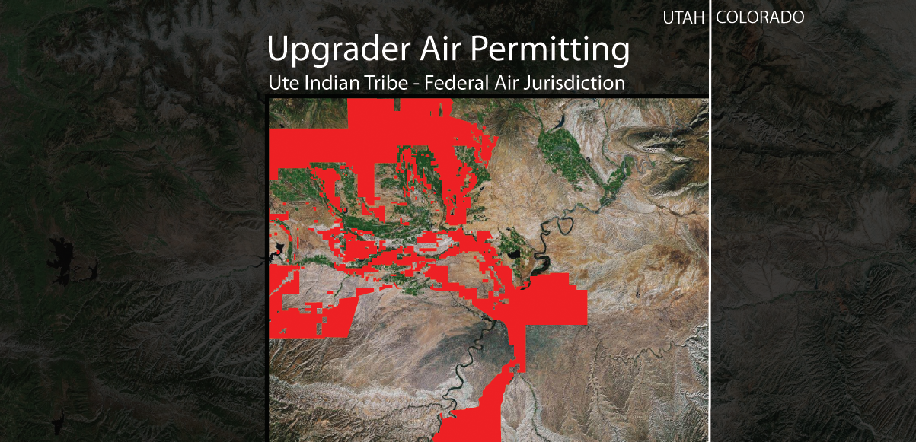
Air Jurisdiction
© Uintah Gateway, LLC 2013 - All Rights Reserved.

Slide 38
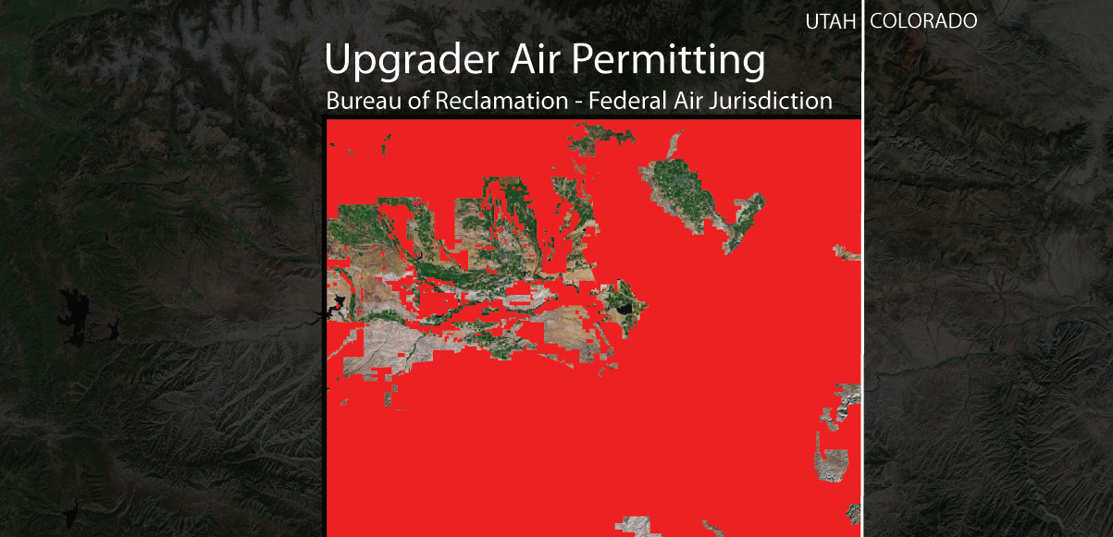
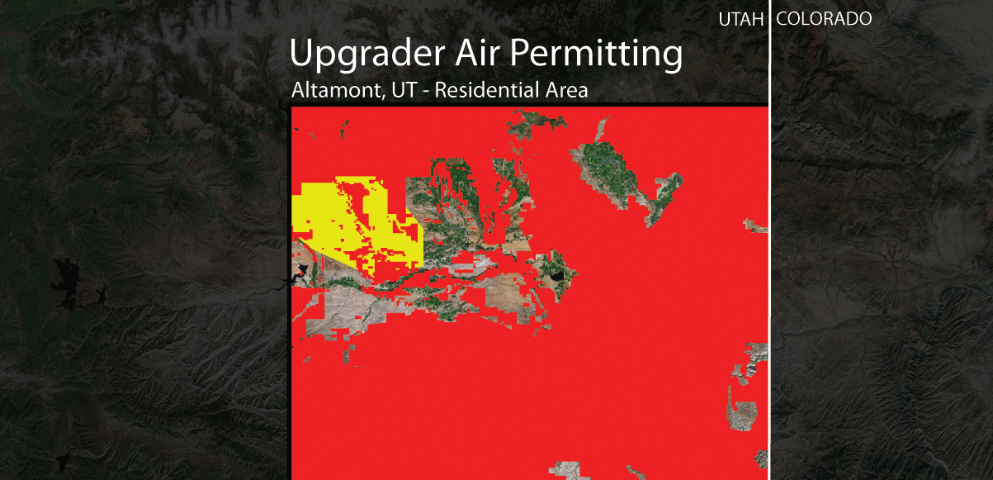
Air Jurisdiction
© Uintah Gateway, LLC 2013 - All Rights Reserved.

Slide 39
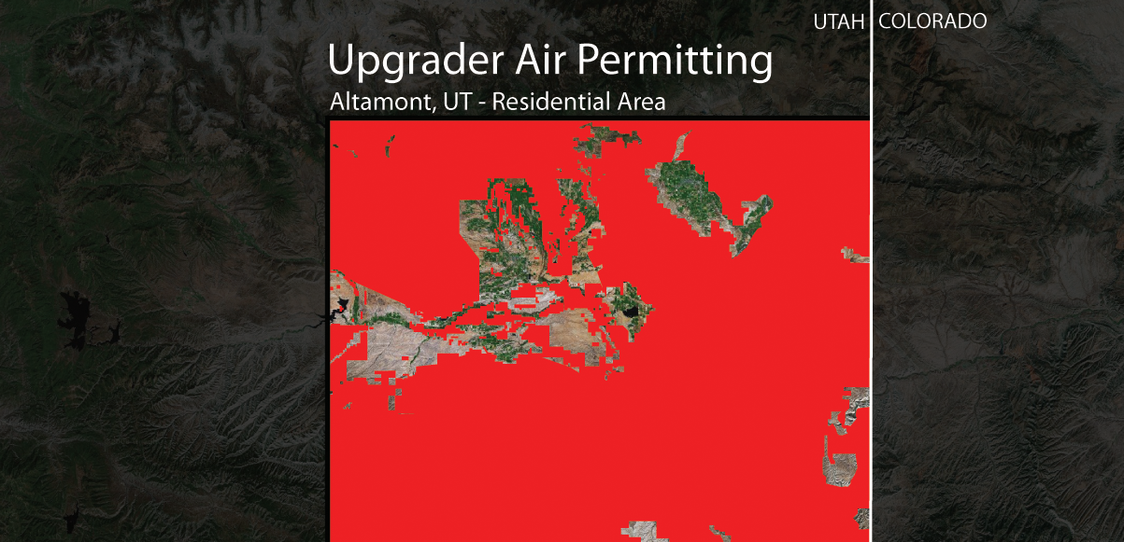
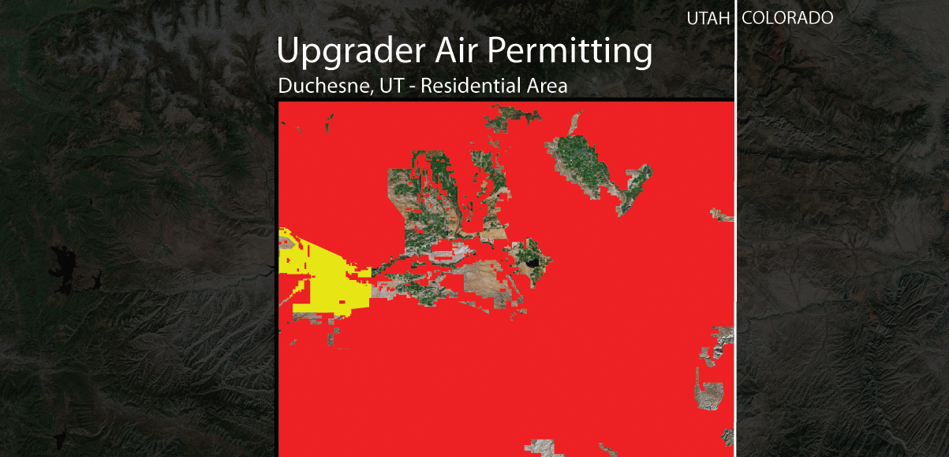
Air Jurisdiction
© Uintah Gateway, LLC 2013 - All Rights Reserved.

Slide 40
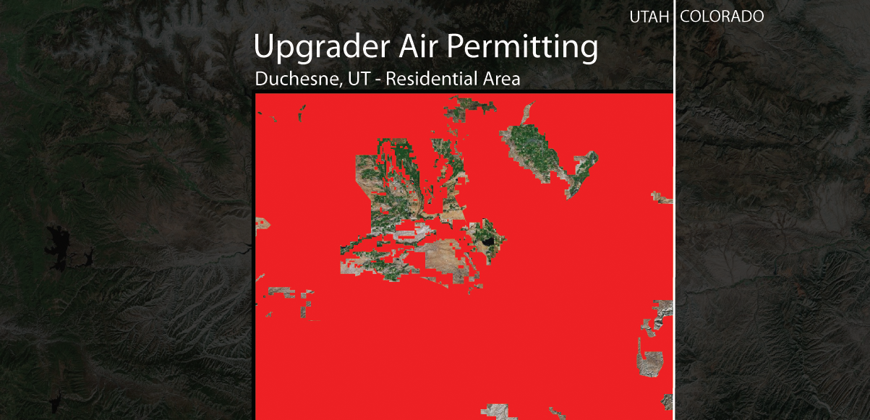
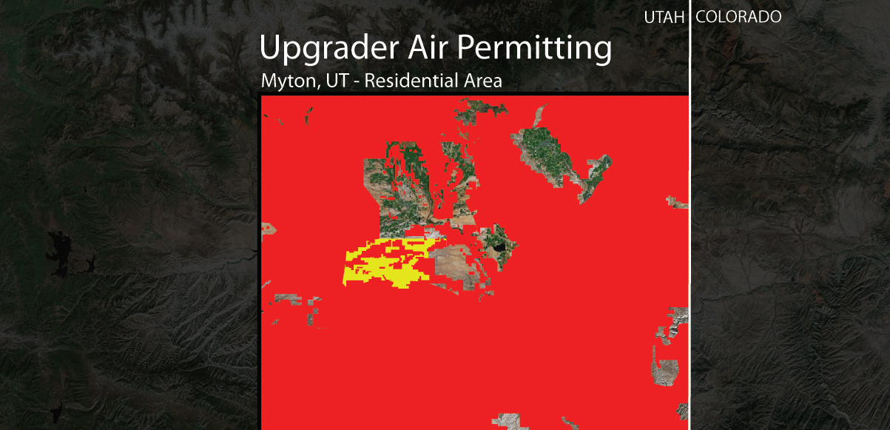
Air Jurisdiction
© Uintah Gateway, LLC 2013 - All Rights Reserved.

Slide 41
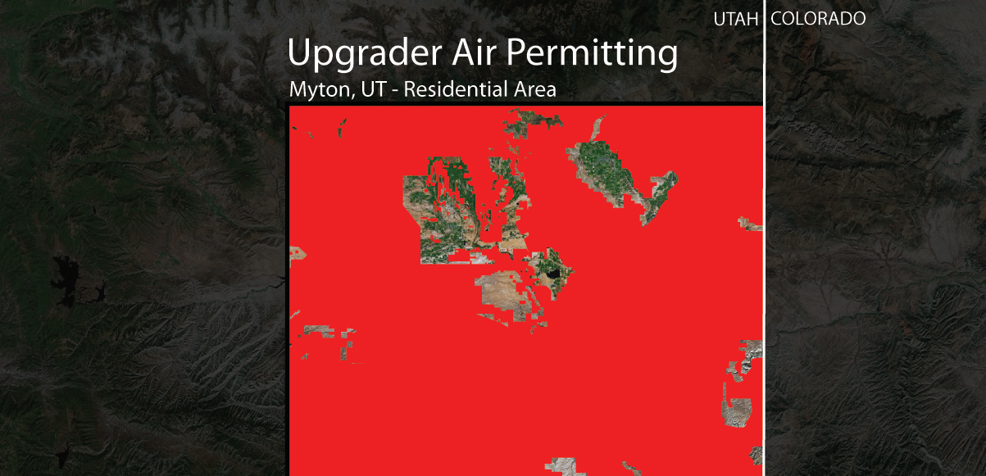
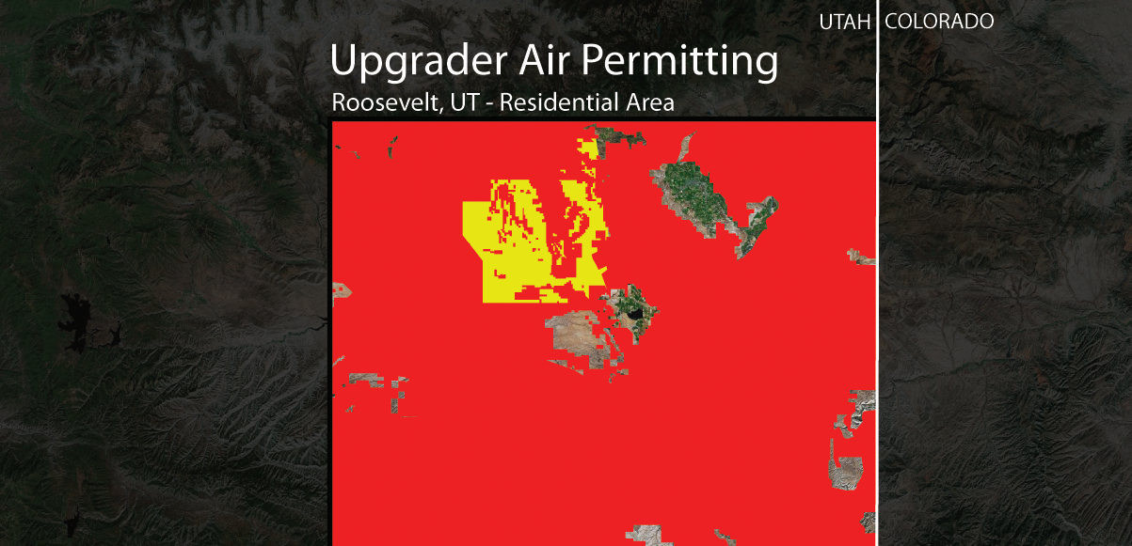
Air Jurisdiction
© Uintah Gateway, LLC 2013 - All Rights Reserved.

Slide 42
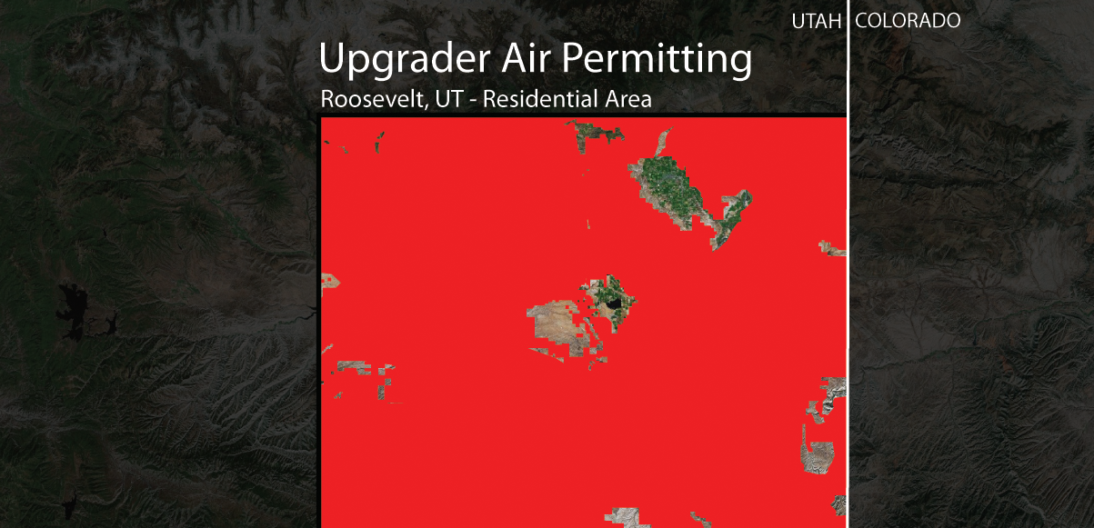
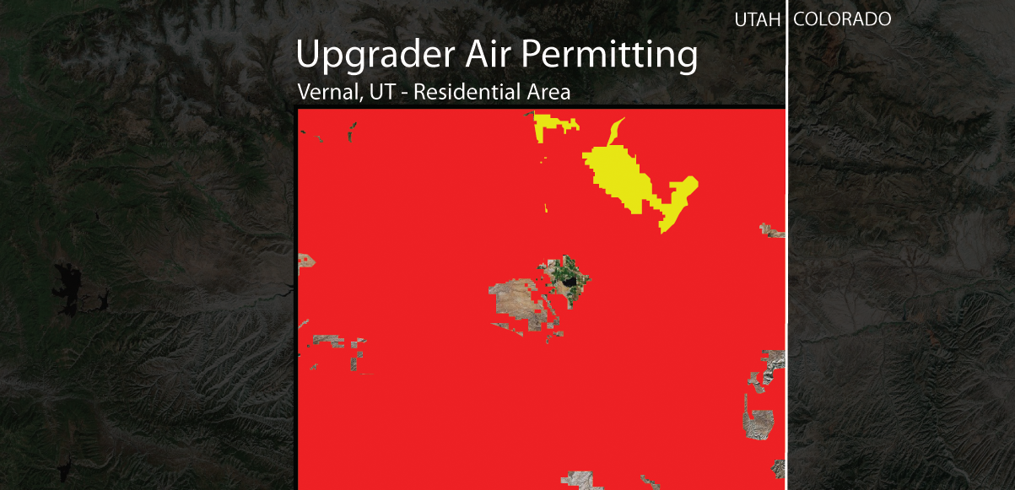
Air Jurisdiction
© Uintah Gateway, LLC 2013 - All Rights Reserved.

Slide 43
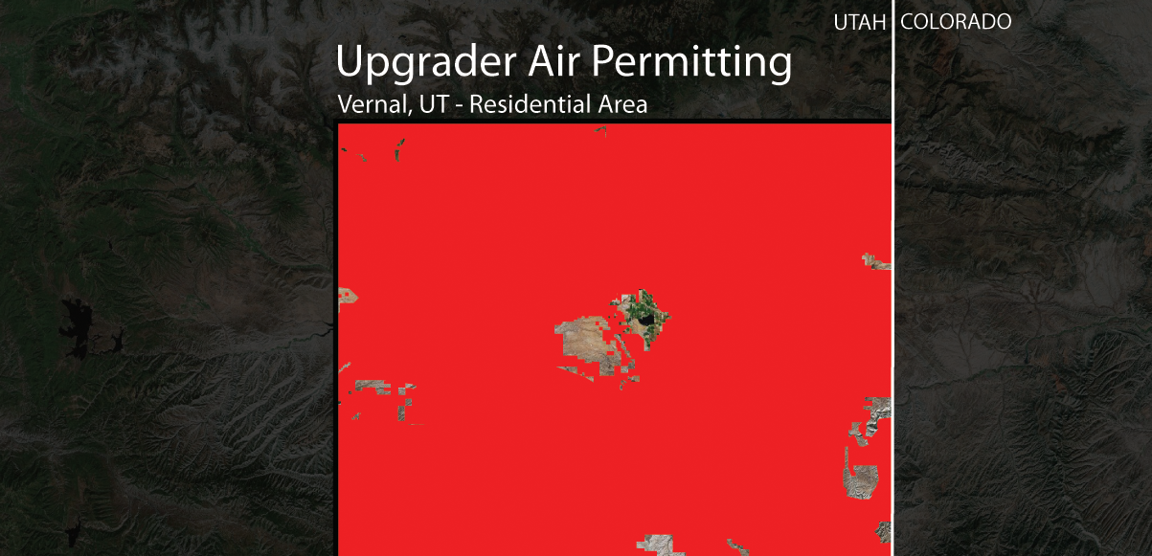
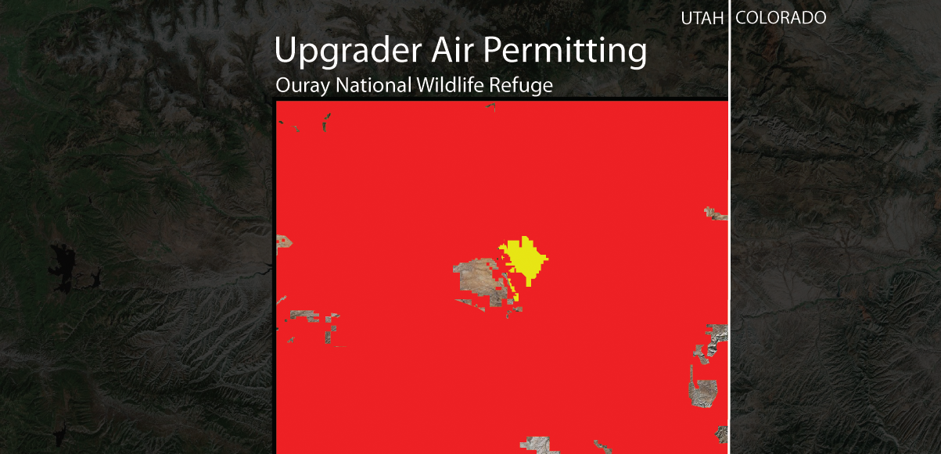
Air Jurisdiction
© Uintah Gateway, LLC 2013 - All Rights Reserved.

Slide 44
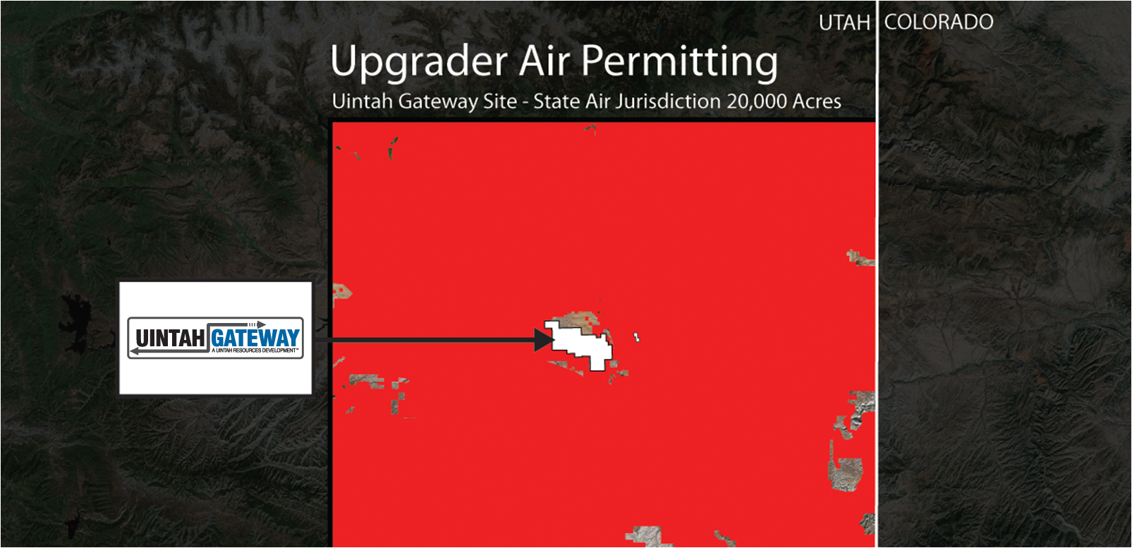
Air Jurisdiction
© Uintah Gateway, LLC 2013 - All Rights Reserved.

Slide 45
Uintah Gateway Project
V – Construction
CONFIDENTIAL - © 2012 Uintah Partners, LLC
© Uintah Gateway, LLC 2013 - All Rights Reserved.

Slide 46
Uintah Gateway Project Overview – International Alliance Group
IAG has been selected to be the Owner’s Representative for the project. IAG is a global leader in the development and program management of refinery projects and turnarounds. Over the past decade, IAG has completed more FCCU revamps and replaced more FCCU reactors than any other company in the world.
IAG, located in Houston, is part of Triten Corporation, which has supplied products and services to industrial customers around the world for more than
60 years.
IAG has served as the single point of responsibility for more than 80 projects valued at over $4 billion.
Management of IAG includes respected leaders in engineering, construction, procurement and refining, and averages nearly 30 years of experience.
IAG’s staff includes former refinery managers, experienced construction superintendents, project managers and all needed project-related experts from the
world’s top engineering and refining companies.
IAG’s projects include:
- Grassroots units and complexes
- Revamps including FCCU, delayed coking, hydro processing and alkylation
- Mid-stream gas processing
- Alternative and renewable energy processing facilities
CONFIDENTIAL - © 2012 Uintah Partners, LLC
© Uintah Gateway, LLC 2013 - All Rights Reserved.

Slide 47
Upgrader Example
CONFIDENTIAL - © 2012 Uintah Partners, LLC
© Uintah Gateway, LLC 2013 - All Rights Reserved.

Slide 48
Uintah Gateway – Crude Unit LKG
1 of 3
CONFIDENTIAL - © 2012 Uintah Partners, LLC
© Uintah Gateway, LLC 2013 - All Rights Reserved.

Slide 49
Uintah Gateway – FCC LKG
2 of 3
CONFIDENTIAL - © 2012 Uintah Partners, LLC
© Uintah Gateway, LLC 2013 - All Rights Reserved.

Slide 50
Uintah Gateway – FCC Crude Units LKG NE Section
3 of 3
CONFIDENTIAL - © 2012 Uintah Partners, LLC
© Uintah Gateway, LLC 2013 - All Rights Reserved.

Slide 51
Uintah Gateway Site Construction
CONFIDENTIAL - © 2012 Uintah Partners, LLC
© Uintah Gateway, LLC 2013 - All Rights Reserved.

Slide 52
Uintah Gateway Site Construction
CONFIDENTIAL - © 2012 Uintah Partners, LLC
© Uintah Gateway, LLC 2013 - All Rights Reserved.

Slide 53
Uintah Gateway Site Construction
CONFIDENTIAL - © 2012 Uintah Partners, LLC
© Uintah Gateway, LLC 2013 - All Rights Reserved.

Slide 54
Uintah Gateway Site Construction
CONFIDENTIAL - © 2012 Uintah Partners, LLC
© Uintah Gateway, LLC 2013 - All Rights Reserved.

Slide 55
Uintah Gateway Site Construction
CONFIDENTIAL - © 2012 Uintah Partners, LLC
© Uintah Gateway, LLC 2013 - All Rights Reserved.

Slide 56
Uintah Gateway Site Construction
CONFIDENTIAL - © 2012 Uintah Partners, LLC
© Uintah Gateway, LLC 2013 - All Rights Reserved.

Slide 57
Uintah Gateway Site Construction
CONFIDENTIAL - © 2012 Uintah Partners, LLC
© Uintah Gateway, LLC 2013 - All Rights Reserved.

Slide 58
Uintah Gateway Site Construction
CONFIDENTIAL - © 2012 Uintah Partners, LLC
© Uintah Gateway, LLC 2013 - All Rights Reserved.

Slide 59
Phase 1 Project Timeline
2013
2014
2015
2016
Q1 2013 | Q2 2013 | Q3 2013 | Q4 2013 | Q1 2014 | Q2 2014 | Q3 2014 | Q4 2014 | Q1 2015 | Q2 2015 | Q3 2015 | Q4 2015 | Q1 2016 | Q2 2016 | Q3 2016 | Q4 2016
Complete LSTK Estimate (SK E&C)
Initial Site Work
Finalize Supply Agreements
Project Finance
Construction of Phase 1 (44,000 bpd)
Operate Phase 1
CONFIDENTIAL - © 2012 Uintah Partners, LLC
© Uintah Gateway, LLC 2013 - All Rights Reserved.

Slide 60
Uintah Gateway Project
VI – Conclusion
CONFIDENTIAL - © 2012 Uintah Partners, LLC
© Uintah Gateway, LLC 2013 - All Rights Reserved.

Slide 61
Uintah Gateway Objectives
Expand the market for wax crude, thereby
removing limitations for increased production
Provide processing options local to the
production area
Produce products that can be transported by
existing pipeline resources
Reduce long haul truck trips to the SLC area
CONFIDENTIAL - © 2012 Uintah Partners, LLC
© Uintah Gateway, LLC 2013 - All Rights Reserved.

Slide 62
May 2nd, 2012 - Utah Governor Signs Resolution of Support for Uintah Upgrading Facility
CONFIDENTIAL - © 2012 Uintah Partners, LLC
© Uintah Gateway, LLC 2013 - All Rights Reserved.

Slide 63
POSITIONING FOR LONG TERM GROWTH
CONTACT INFORMATION
U.S. OFFICE
3165 E Millrock Drive Ste. 550
Salt Lake City, UT 84121-5563
Tel +1 (435) 200 6800
Fax +1 (435) 608 6395
www.uintahpartners.com
info@uintahpartners.com
©2013 Uintah Partners, LLC
ALL RIGHTS RESERVED

