Slide 1
How the West is Run
A Deep Dive into Global, National & Regional Petroleum
Tom Kloza, Global Head of Energy Analysis
Oil Price Information Service by IHS Markit
February 21, 2019 The Mirage, Las Vegas, NV

Slide 2
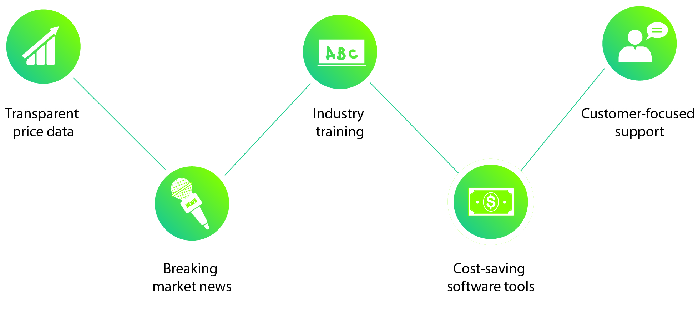
OPIS provides you direct, multi-platform access to:

Slide 3
OPIS is a fuel pricing benchmark
OPIS directly impacts nearly 100 billion gallons of fuel per year
Businesses have fuel contracts based on OPIS pricing for 10+ years into the future
OPIS is listed as a settlement mechanism on global commodity exchanges
OPIS pricing methodology is approved by IOSCO (International Organization of Securities Commissions)

Slide 4
The Oil World in Three Pictures . . .

Slide 5
12-million barrels per day

Slide 6
11.8-million barrels per day

Slide 7
12-million barrels per day

Slide 8
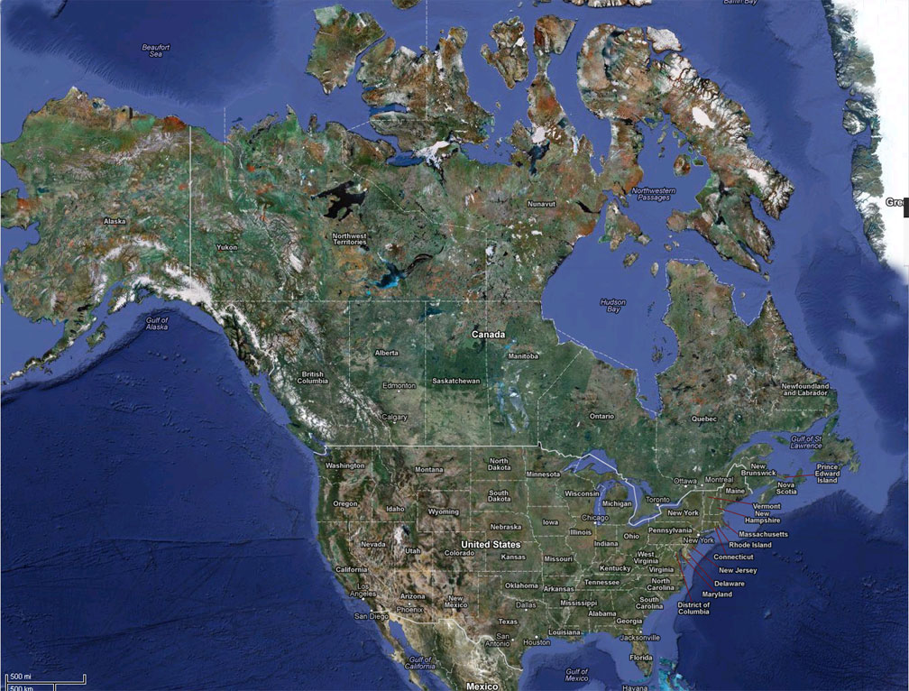
North American Diversity Crude – 5 Years Ago
8
• ANS - $104/bbl
• WCS – Hardisty, Alberta - $76/bbl
• Bakken - $93/bbl
WTI – Cushing, OK- $94.35/bbl •
• West African - $108/bbl
WTI – West Texas - $92.75/bbl •
WTS – West Texas - $92.60/bbl
• LLS Sweet Crude - $108.00/bbl

Slide 9
North American Diversity - Today
9
• ANS - $63/bbl
• WCS – Hardisty, Alberta - $41/bbl
• Bakken -$55.50bbl
WTI – Cushing, OK- $56.00/bbl •
• Brent - $66.50 bbl
WTI – West Texas - $57.00/bbl •
• LLS Sweet Crude - $63.00 bbl

Slide 10
The Wildcard that Complicates the Menagerie

Slide 11
Myth: Prices Can’t Possibly Go Sharply Lower or Higher

Slide 12
Some Notes on Scale
Futures participation has screamed higher, and something like two out of three trades are algorithmic or computer-generated. Participation has now surpassed 7-million futures’ contracts, or about 7-BILLION BARRELS, in the cornerstone energy contracts (WTI, Brent, Gasoil, ULSD and RBOB). This does not even consider options and derivatives.
Volume records were broken on a daily, weekly and monthly basis. On May 8, we traded more than 3.5-billion barrels of WTI and Brent. But participation has dropped dramatically since May 2018.
Nine of the ten largest funds are programmed and algorithmic. Most of the trading each day is from machine-to-machine. (Be careful if your name is Sarah Connor)
Beyond the increased participation and market growth, the number of oil experts and analysts has grown exponentially as well.
But, among senior analysts, I have the best hair.
Money flow dwarfs all other fundamentals and will continue to do so. FOMO, MCM and DM dominated January and February in particular. But suddenly, in the last month, the geopolitical calendar has become crowded with events that can inspire volatile moves.

Slide 13
The Growth of Automated Trading in Futures Markets
Participants must adapt to changing landscape of the market
March 2017 CFTC Report
As markets mature electronically, client segments have implemented execution algorithms to improve performance and reduce overall costs of trading.
As of March 2017, approximately 63% of every trade in crude trade was executed via an automated strategy. These numbers are up from 54.3% in March 2015, the first year the study was conducted. What might they be now?

Slide 14
Let’s Take a Quick Look at North American Refining

Slide 15
Refining in the 2020’s

Slide 16
Century 21: The Uneven Changes in U.S. Refining Capability
12/31/1999 Current Change
Nationwide 16.276-mil b/d 18.603-mil b/d + 2.327-mil b/d
PADD 1 1.691-mil b/d 1.224-mil b/d - 467,000 b/d
PADD 2 3.578-mil b/d 4.094-mil b/d + 516,000 b/d
PADD 3 7.418-mil b/d 9.765-mil b/d + 2.347-mil b/d
PADD 4 528,000 b/d 683,000 b/d + 155,000 b/d
PADD 5 3.061-mil b/d 2.838-mil b/d - 223,000 b/d

Slide 17
The Creepy West (Population)
17
State End-20th Century Jan 2020* Change
WASHINGTON 5.89-MILLION 7.70-MILLION +1.810-MILLION
OREGON 3.42-MILLION 4.30-MILLION +0.880 MILLION
CALIFORNIA 33.80-MILLION 40.00-MILLION +6.200 MILLION
IDAHO 1.29-MILLION 1.80-MILLION +0.510 MILLION
MONTANA 0.902-MILLION 1.08-MILLION +0.178-MILLION
UTAH 2.230-MILLION 3.30-MILLION +1.070-MILLION
NEW MEXICO 1.820-MILLION 2.10-MILLION +0.280-MILLION
NEVADA 1.990-MILLION 3.10-MILLION +1.111-MILLION
TOTAL REGION 51.342-MILLION 63.380-MILLION +12.038-MILLION
Notes:
Manufacturing 7-million gallons less gasoline per day for 12-million more people.

Slide 18
What do These Numbers Tell Us?
The notion of just-in-time inventory has become incredibly regional. We’ll see U.S. Gulf Coast refinery capacity top 10-million b/d in the next few years, and only hurricanes can disrupt that region and the East Coast which will be the target of many of the new barrels.
The Rocky Mountain region has added the equivalent of just one medium size refinery as its population has swelled in the last 20 years.
The West Coast is the poster child for just-in-time. The loss of a single refinery for any length of time can have dramatic consequences. Examples in 2018 were Salt Lake City & Seattle.
The Rockies will get some help from small shale basins with additional crude oil from some of the lesser known basins. This will help refiners but will it help marketers.

Slide 19
So Far, Turnaround Season has been Reasonably Smooth EOR

Slide 20
A Tale of Two Cities Salt Lake City & Seattle 2018

Slide 21
Nationwide Rack to Retail Margins 2018
33.1
29.7
33.1
35.2
34.1
30.2
26.9
21.7
38.6

Slide 22
Western State 2018 Margin Rankings
Overall Rank | WPMA State Rank | State | 2018 Margin
1 | 1 | Oregon | 46.1
2 | 2 | California | 43.8
4 | 3 | Washington | 42.1
17 | 4 | Montana | 27.1
20 | 5 | Idaho | 24.2
22 | 6 | New Mexico | 24.2
32 | 7 | Utah | 21.3
34 | 8 | Nevada | 20.9

Slide 23
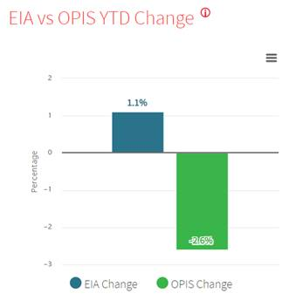
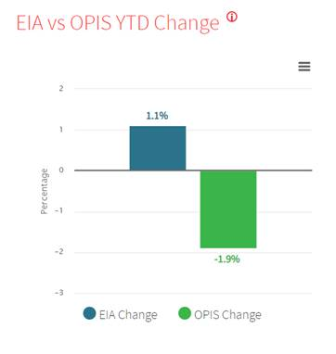
Gas Demand Disappointment
West
Southwest
West Region Includes: CA, CO, HI, ID, MT, NV, OR, UT, WA & WY
Southwest Region Includes: AZ, NM, OK, TX

Slide 24
Observations on U.S. Refining Trends
This is a spring of lots of refinery maintenance. Last chance for a lot of refiners to do work necessary for IMO 2020.
Despite the statistical cluster of February refinery woes, voluntary cuts are possible. Gasoline has been a dog for non-integrated refineries in most portions of the country.
Has North American refining been overbuilt? Europe certainly has been. Meanwhile, US public refineries with Master Limited Partnership structures are struggling with those woes.
All things considered, gasoline should be a surplus product for 6-8 months out of the year, unless something hits the fan.
IMO 2020 could be the possible game-changer, but mostly for processors who have access to tidal water.

Slide 25
Our Thoughts on Gasoline Demand
The big gasoline demand slide in the US is still years away…but how many?
Demand could drop somewhere between 400,000 b/d to 700,000 b/d by 2025
That would put annual demand in the 8.5 million b/d to 8.9 million b/d range by 2025…Compared to ~9.3 million b/d 2016-2018
A recession could also curb demand. The great recession knocked off about 300,000 b/d of gasoline demand
Octane may or may not be a big deal over the next decade…OEM’s want more of it in gasoline to meet CAFE standards but some feel that the octane ship has sailed.
More light tight oil does have consequences.
RINs and E-15? Slow adoption of the higher ethanol blended gasoline. RIN prices have cooled off significantly. Corn and ethanol prices look likely to remain cheap for the time being, but it is RIN prices that is the lever that brings about E15 adoption. Not much incentive in WOR markets.
Fewer boutique blends? Might make it easier for refiners and marketers, but it is those specialized blends that can be very profitable
Profitability for gasoline depends on volatility. Should come in fits and starts

Slide 26
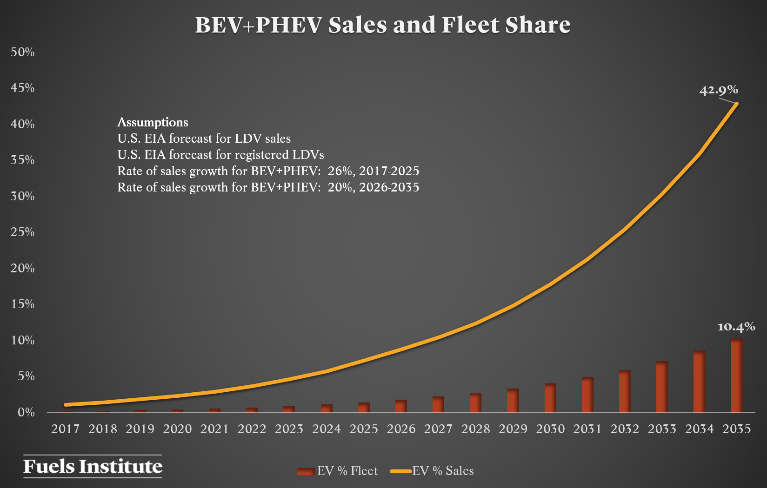
…and where we are going

Slide 27
What Demand Projections Looked Like Before Trump & Pruitt

Slide 28
Gasoline Demand Considerations After Pruitt-Café Decision
Still plenty of uncertainty. Yet to hear from National Highway Traffic Safety Administration, California and other decarbonization states.
Freezing CAFÉ standards at MY 2021 doesn’t arrest the lower demand curve. It tempers it.
My personal estimate is that gasoline demand drops between 400,000 b/d and 700,000 b/d by 2025. That puts annual demand between 8.5-million b/d and 8.9-million b/d by 2025, compared to ~9.3-million b/d from 2016-2018.
Back-of-the-envelope calculations would dictate that gasoline “lumpiness” continues. That means that mid-decade demand might vary from 7.75-million b/d and 9.3-million b/d.
Great Recession knocked demand down by ~300,000 b/d – high-priced Arab Spring years lopped off about the same from a cheap 2010 to expensive 2012 (CAFÉ helped).
Most of the demand destruction is from 2020-2025. One top consultant puts 2020 at 9.311-million b/d, but sees 2025 at 8.855-million b/d and 2030 at 8.273-million b/d.

Slide 29
Paradoxical Intention – EV Adoption has a Flip Side
Impact on equities – Oil & Gas valuations have been impacted by cheap mid-decade prices and fears of EV intrusion. Traditionally accounted for 10-15% of U.S./European indices, but it’s on 5% these days.*
Focus on EVs and Lower Carbon Impacts have kept money out of long cycle oil projects. Consumer choice based on price saving not happening because of rapid rise in shale output and cheap-to-modest background prices.
Goldman Sachs estimates that, at most – about 1-million b/d to 4-million b/d of oil demand will be destroyed by EV adoption through 2030. That’s less than one year of global decline. And, it pales compared to about 6-million b/d of oil production lost by projects that have been cancelled since 2014 price collapse.
Bottom line: the threat of EV adoption has a “net tightening effect” on the market into the next decade.
Battery costs: 50% drop needed to compete with ICE. Might happen, but probably late in the next decade, and without provoking inflation in key markets needed. Metal markets might have to expand three to eightfold.
Tax revenue issue for governments.
After 2030, things change. Morgan Stanley estimates EVs will account for 48% of miles traveled by 2040. Suggest that only “niche” stations will thrive.

Slide 30
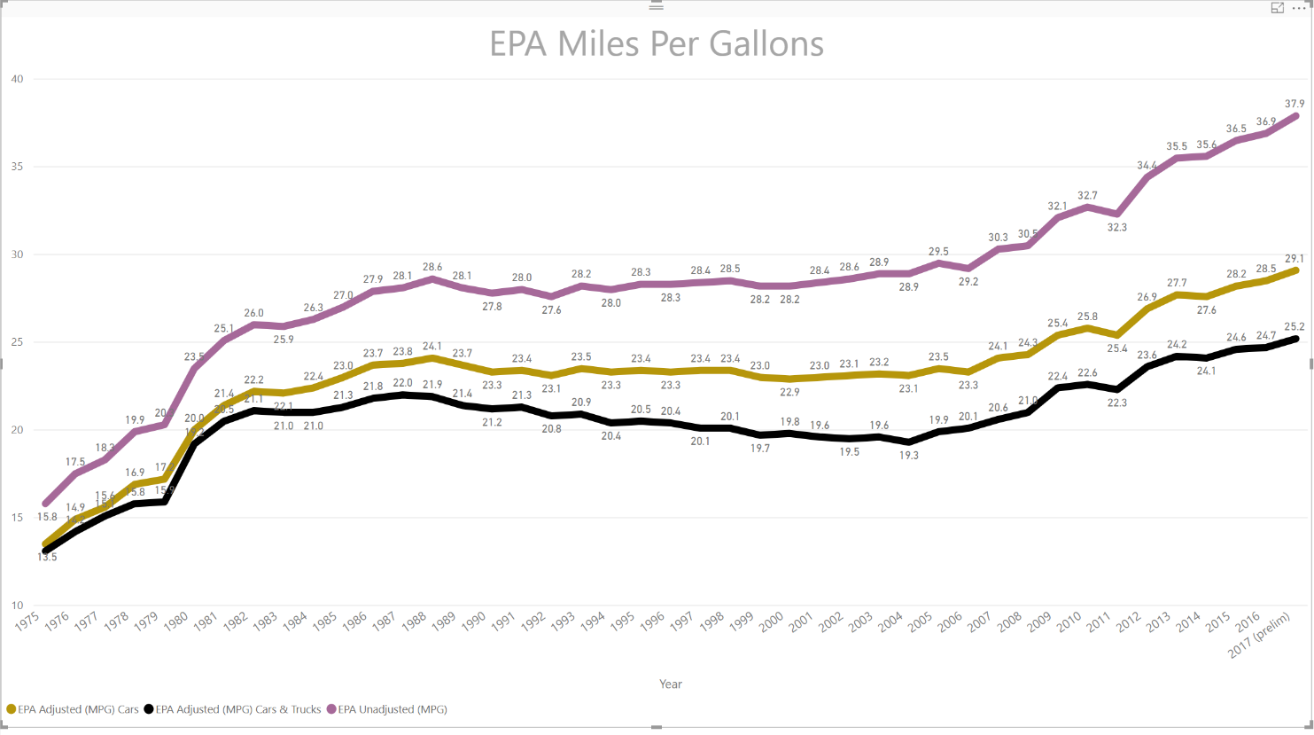
Engine Efficiency is the Biggest Threat to Gasoline Demand Going Forward

Slide 31
Americans are Holding onto Vehicles Longer
In 2009 the average vehicle (cars, trucks and vans) age was 9.3 years
In 2017 the average vehicle age jumped to 10.5 years
Slower vehicle turnover has implications for gasoline demand
The 2008 model fuel efficiency is not as good as 2018 model
But then again, the 2008 model efficiency is better than an early 2000’s model
Income plays a large role in vehicle turnover
Lower income households hold onto vehicles longer then higher income households.
As a result, lower income families spend more of their income on fuel

Slide 32
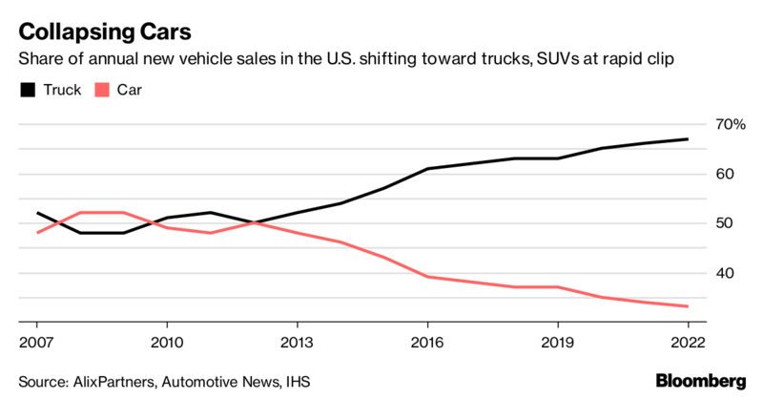
One Reason Why Demand is Likely to Remain Steady

Slide 33
Is Diesel Getting its Mojo Back?
Short answer…yes, it is.

Slide 34
The IMO 2020 Rules
Why This is Going to be a Big Deal

Slide 35
IMO 2020: The most significant change in fuel specifications for decades
Potential for significant disruption
The International Maritime Organization (IMO) agreed to reduce the sulfur content of marine fuel from 3.5% to 0.5% from January 2020
1
Global change
2
The need to find alternative outlets for the unwanted high sulfur residues
3
High cost of compliance regardless of route

Slide 36
Refiners will need to make some changes in order to meet growing demand for low sulfur bunker fuel and avoid unwanted residue
1
Change the type of crude they process
2
Develop new blends/formulations
What options for refiners?
3
Invest in conversion/desulfurization capacity
4
Find a new home for HSFO

Slide 37
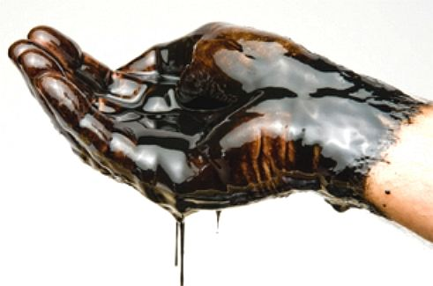
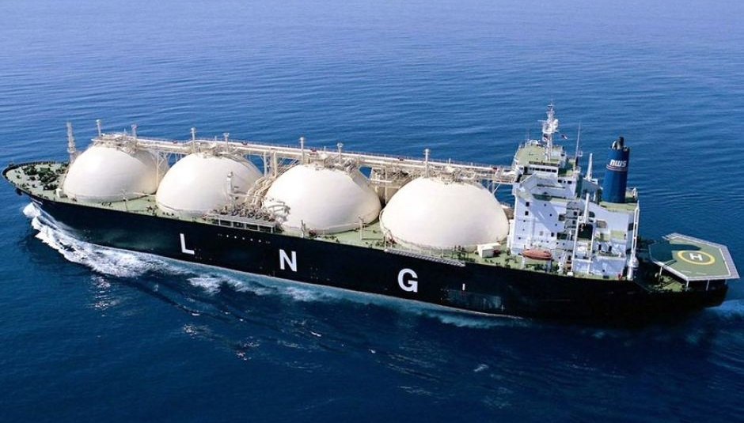
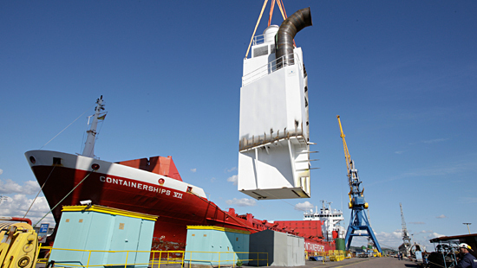
Ship owners and charterers will have various options to comply with new regulation
4
Switch to a compliant fuel
3
Non-compliance
2
Switch to LNG (or other alternative fuel)
1
Install scrubbers

Slide 38
Get to Know…IMO
U.S. refiners, particularly on the coasts, stand to be the big winners
On the surface this would be bearish for heavy, sour crudes, but not all crudes are created equal.
The birth of dirty diesel.
The big question: will the intermediate gasoil (VGO) go to the marine market instead of being processed through conversion units and becoming gasoline or ULSD?

Slide 39
Some Final Predictions
Crude oil costs are coming down drastically. Some shale producers make more money now at $50 bbl than they made at $100 bbl in 2012.
Look for ridiculous numbers for US crude output as long as WTI remains above $50 bbl. A world with 15-million b/d of US output and 5-million b/d of exports is possible if not probable.
US refining capability EOR is in excess. A slowdown in Central and South America would be a disaster for light product prices in NY, Houston, Chicago and Group 3.
The seasonality of gasoline will continue as time goes on. There are fundamental reasons why this market is bipolar.
Diesel could be ascendant in the early portion of the next decade. Silly prices could prevail.

Slide 40
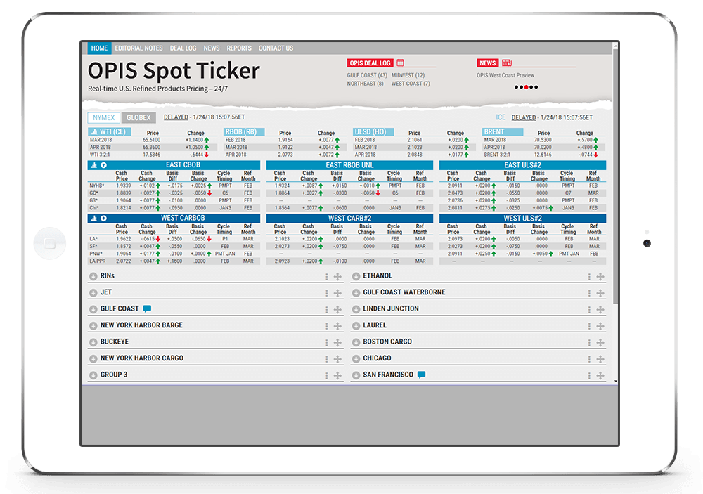
OPIS Spot Ticker
Live gasoline, diesel and jet fuel pricing ticker helps fuel traders, suppliers and marketers anticipate market volatility and better time your sales/purchases to save money.
The OPIS Spot Ticker connects you to the fuel price influence chain – spot, rack and retail markets – in real-time, all day long. This web-based tool shows live NYMEX prices alongside real-time trades and expert assessments of every grade of gasoline, diesel and jet fuel East of the Rockies and on the U.S. West Coast.
Preview the OPIS Spot Ticker free for 10 days to access live fuel prices. Try the Spot Ticker online or try the Mobile Spot Ticker app for access on-the-go.
Try the Spot Ticker free for 10 days
www.opisnet.com/opis-spot-ticker

Slide 41
West Coast Spot Market Report
Benchmark gasoline, diesel and jet fuel pricing with expert market commentary.
Nearly every gallon of gasoline, diesel and jet fuel sold on the West Coast references OPIS spot prices, making it an essential price reference for anyone doing business in the region.
Our spot market editors are immersed in the west coast market, earning a reputation for accuracy in full-day price reporting and breaking news and analysis. They have a deep understanding of the complex west coast fuel sector and it’s regulatory challenges and provide the expert insight you need to monitor prices, compliance and make informed business decisions.
Try the OPIS West Coast Spot Market Report free for 10 days.
www.opisnet.com/west-coast

Slide 42
Questions & Answers

Slide 43
Thank You!
43
Questions, Comments?
Contact:
Tom Kloza
Tom.Kloza@ihsmarkit.com
732-730-2558
Twitter: @tomkloza

